Slide 1
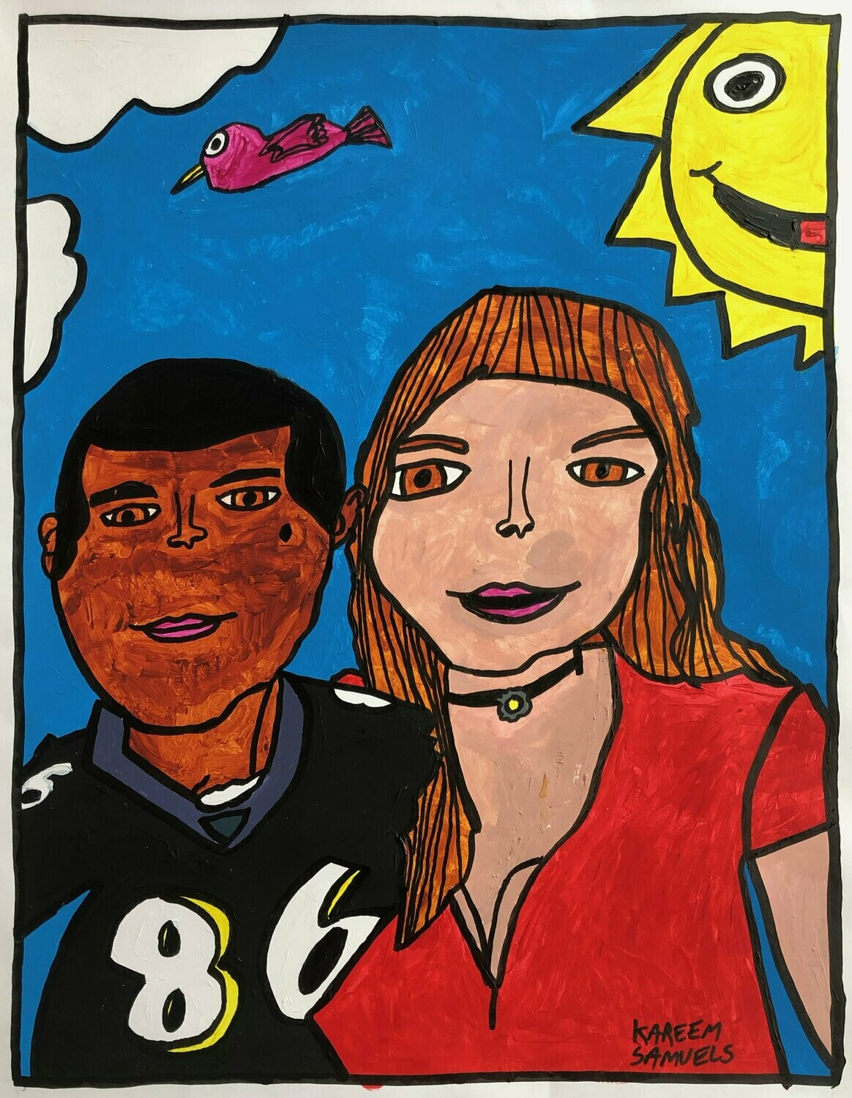
It’s a Wonderful Life
Artist: Kareem Samuels

Slide 2
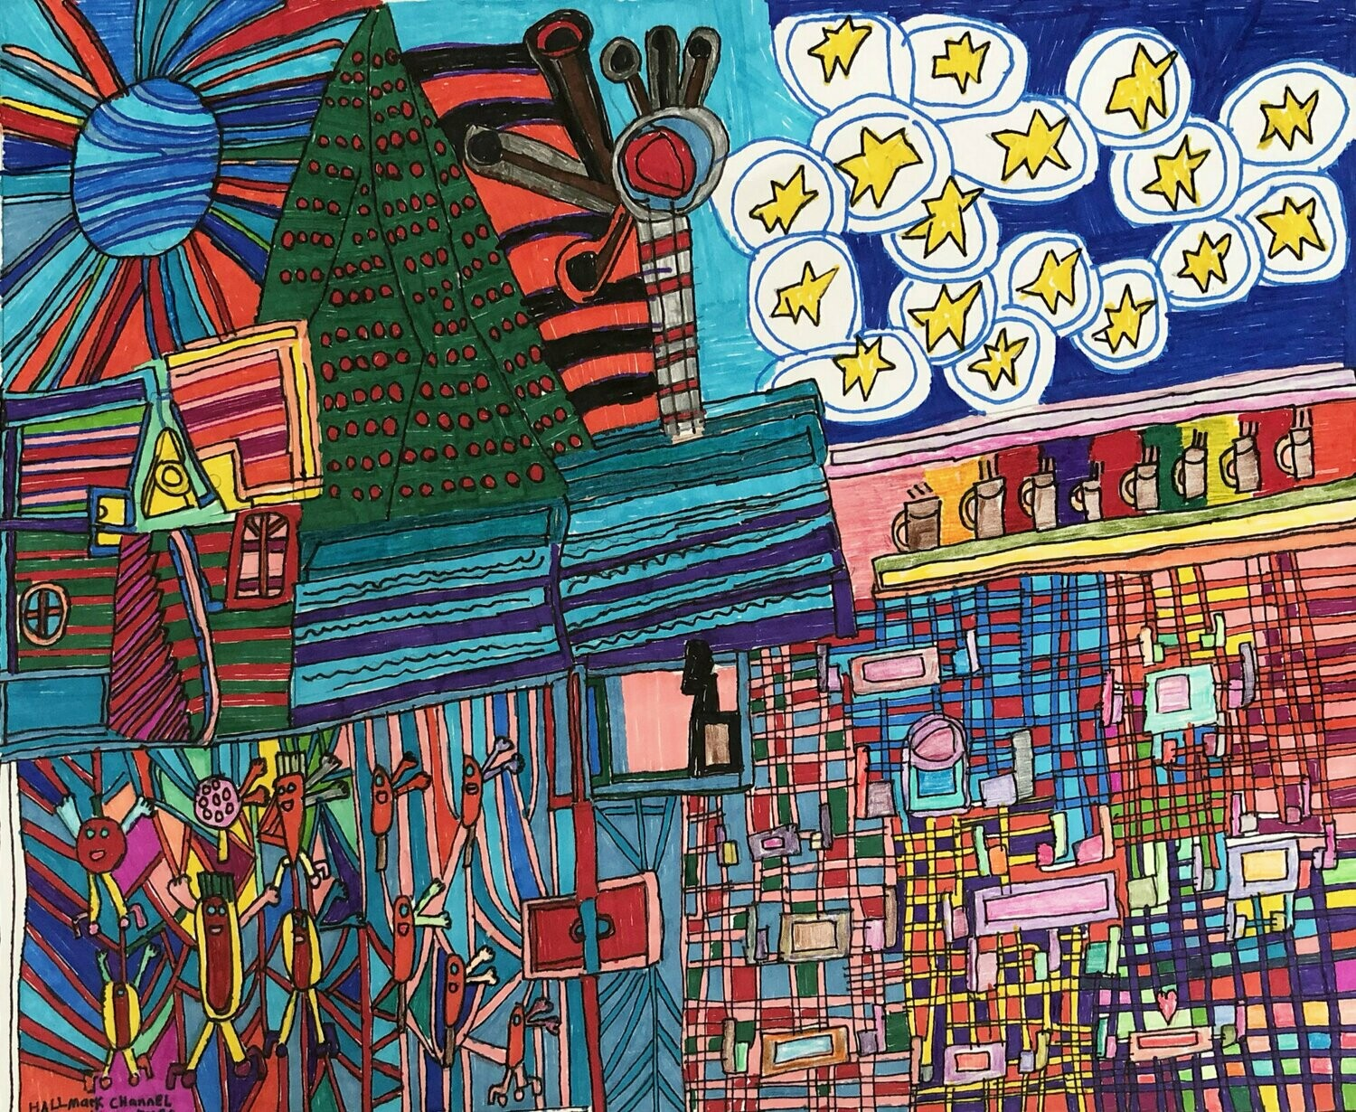
Starry Deviled Egg Sky
Artist: Margie Smeller

Slide 3
The Last Action Hero
Artist: Toni LaBate
Notes:
Image description:
Batman and Robin drawing with text that reads, “With the help of a magic ticket handed down by Harry Houdini which was given to him by the best magician in Indiana, which was given to him by the best magician in Tibet and now the magic ticket handed down by Harry Houdini is given to me.” The second and third drawings are identical and show a person handing the ticket to someone else. The text for the second drawing reads, “Garrett’s dad Bruce giving me the magic ticket handed down by Harry Houdini.” The text for the third image reads, “Bill Kristel giving me the magic ticket handed down by Harry Houdini.” In the fourth image the ticket is being handed off between two characters on a computer screen and then laying on the keyboard in front of a blank computer monitor. The text reads, “Me and the character Barbara Gordon, Commissioner Gordon’s librarian daughter stepping out of the fantasy world and into the real world with the magic ticket.”

Slide 4
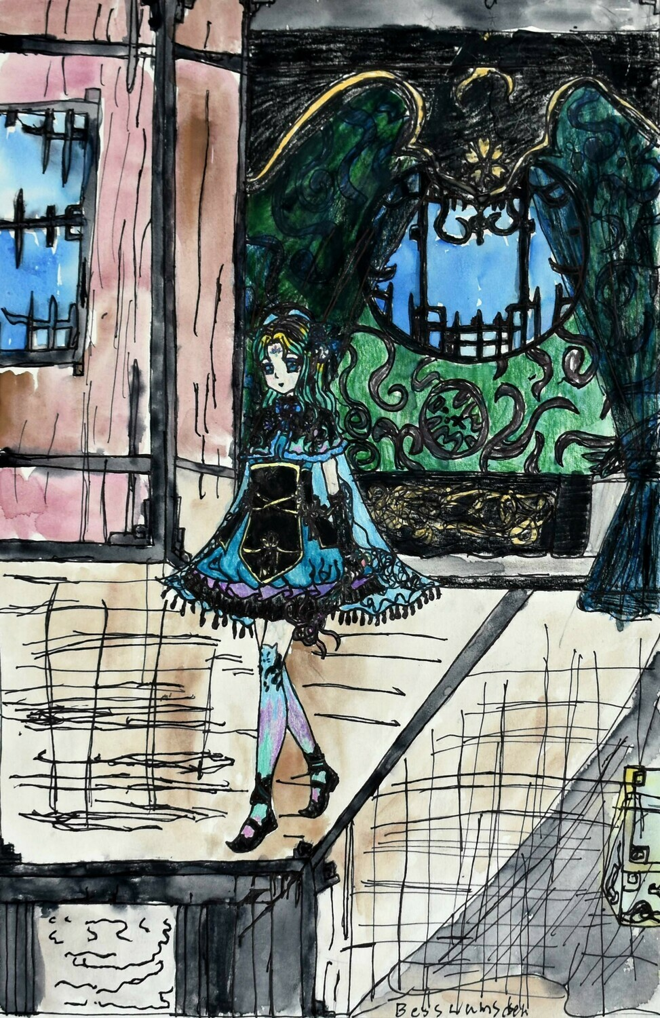
Princess in Her Bed Chambers
Artist: Bess Lumsden

Slide 5
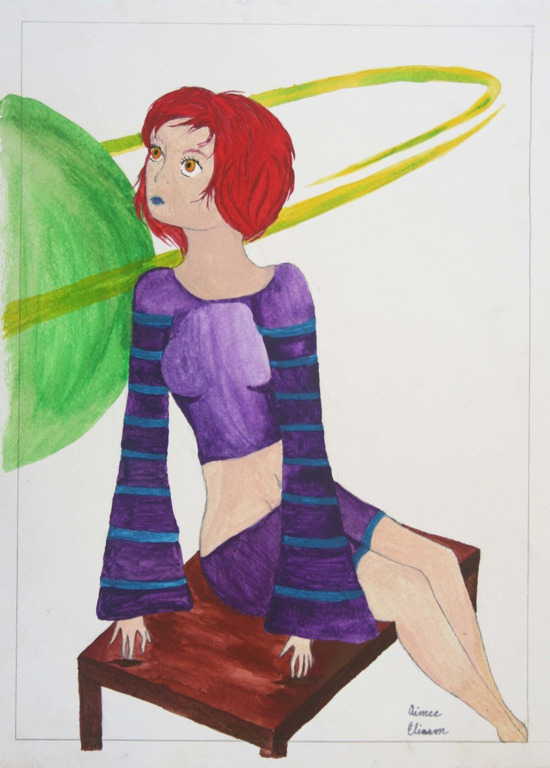
Mia’s Day Dream Space
Artist: Aimee Eliason

Slide 6
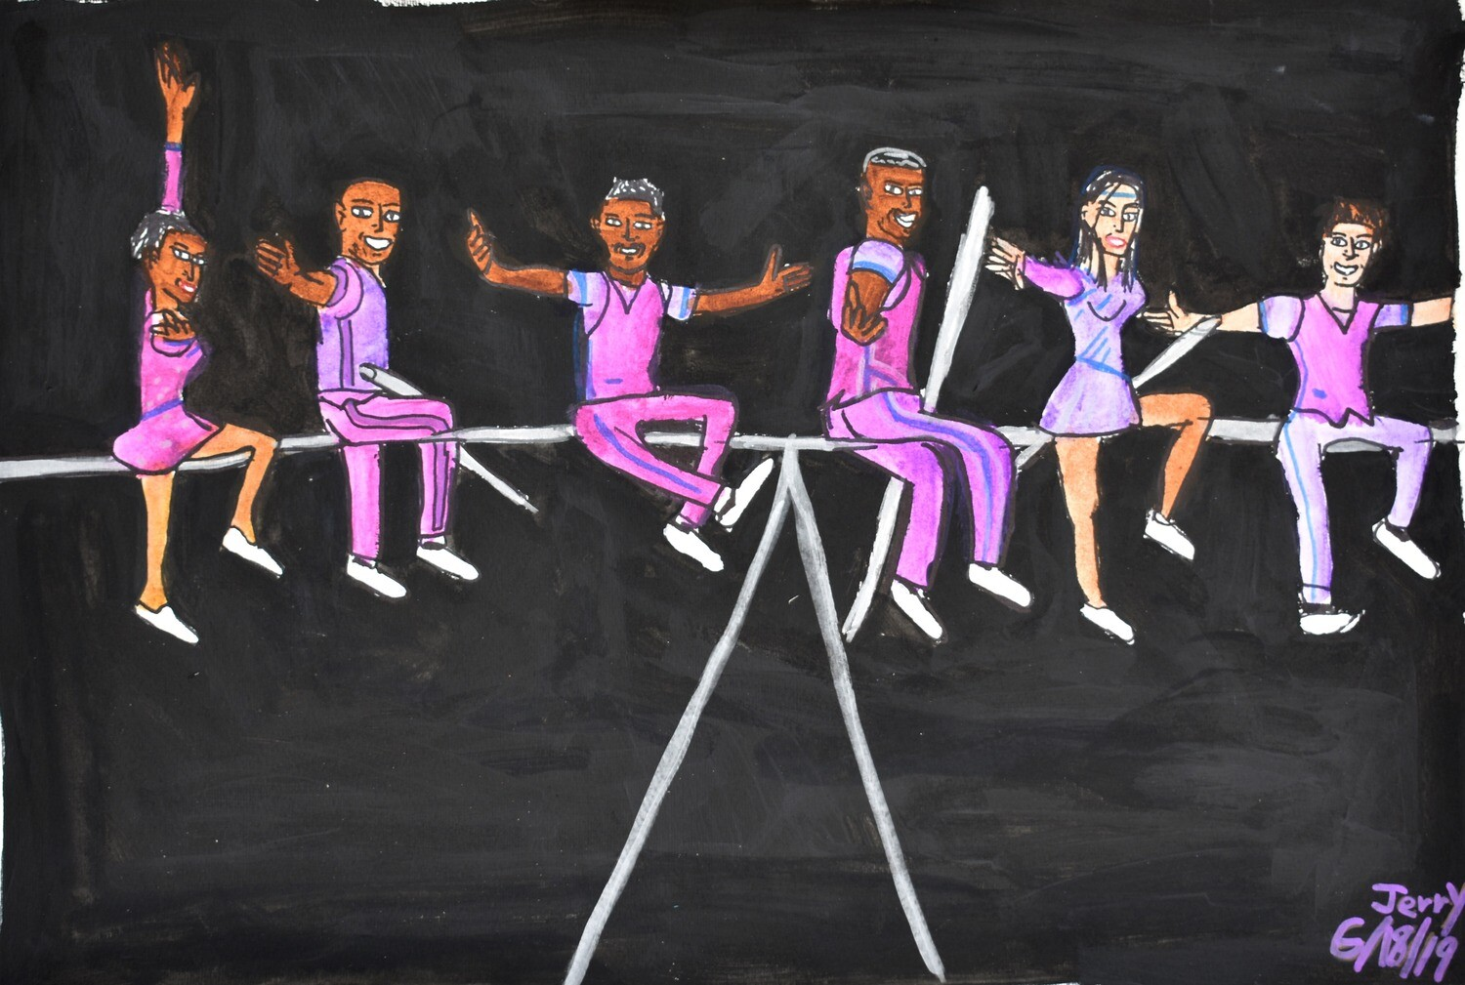
The Willy Family
Artist: Jerry Williams

Slide 7
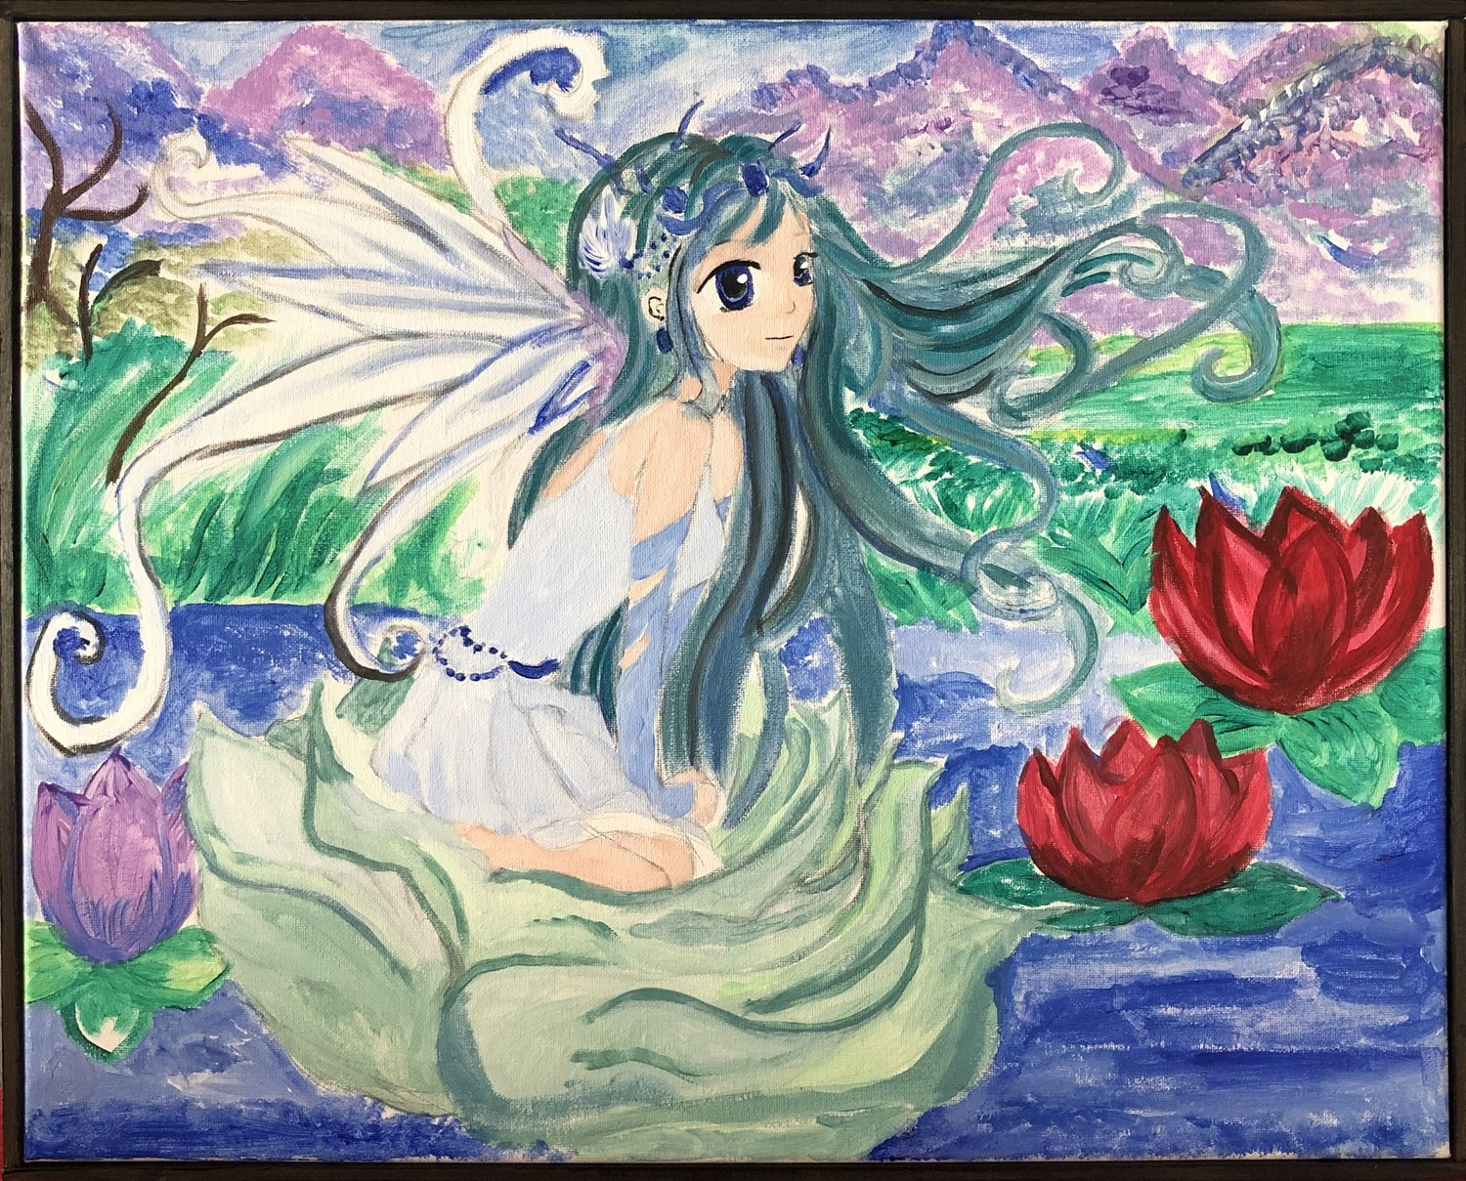
Elf
Artist: Janel Jenkins

Slide 8
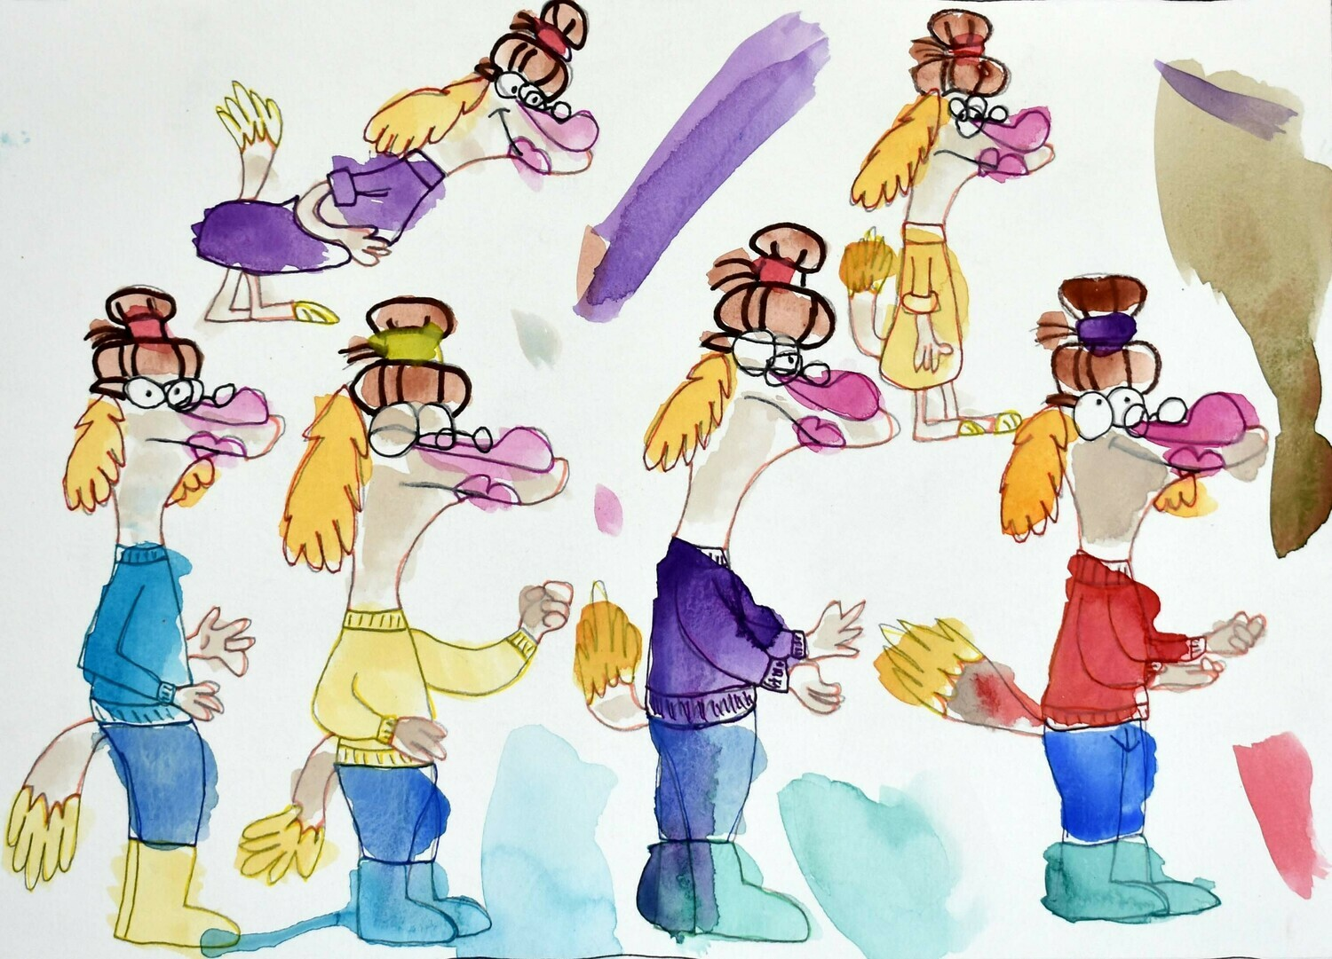
Aunt Rivas
Artist: Laura Curtis

Slide 9
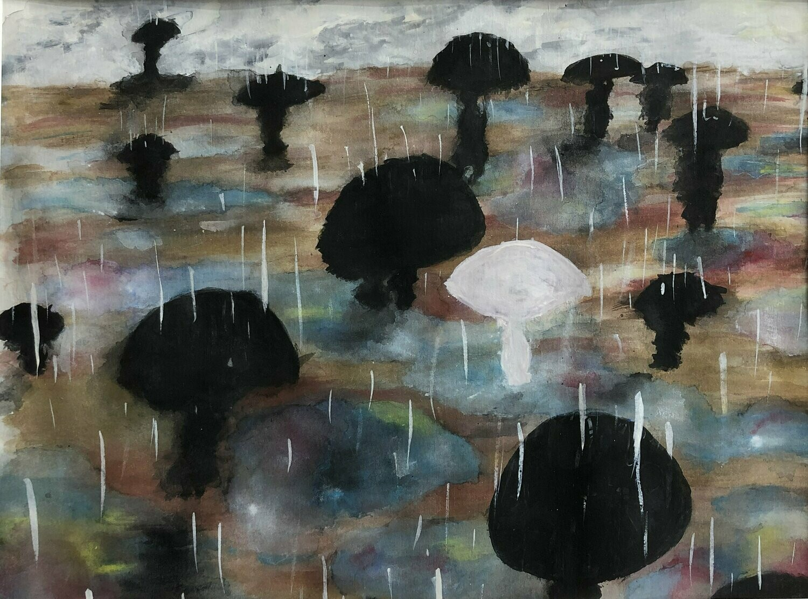
Rainfall
Artist: Erika Clark

Slide 10
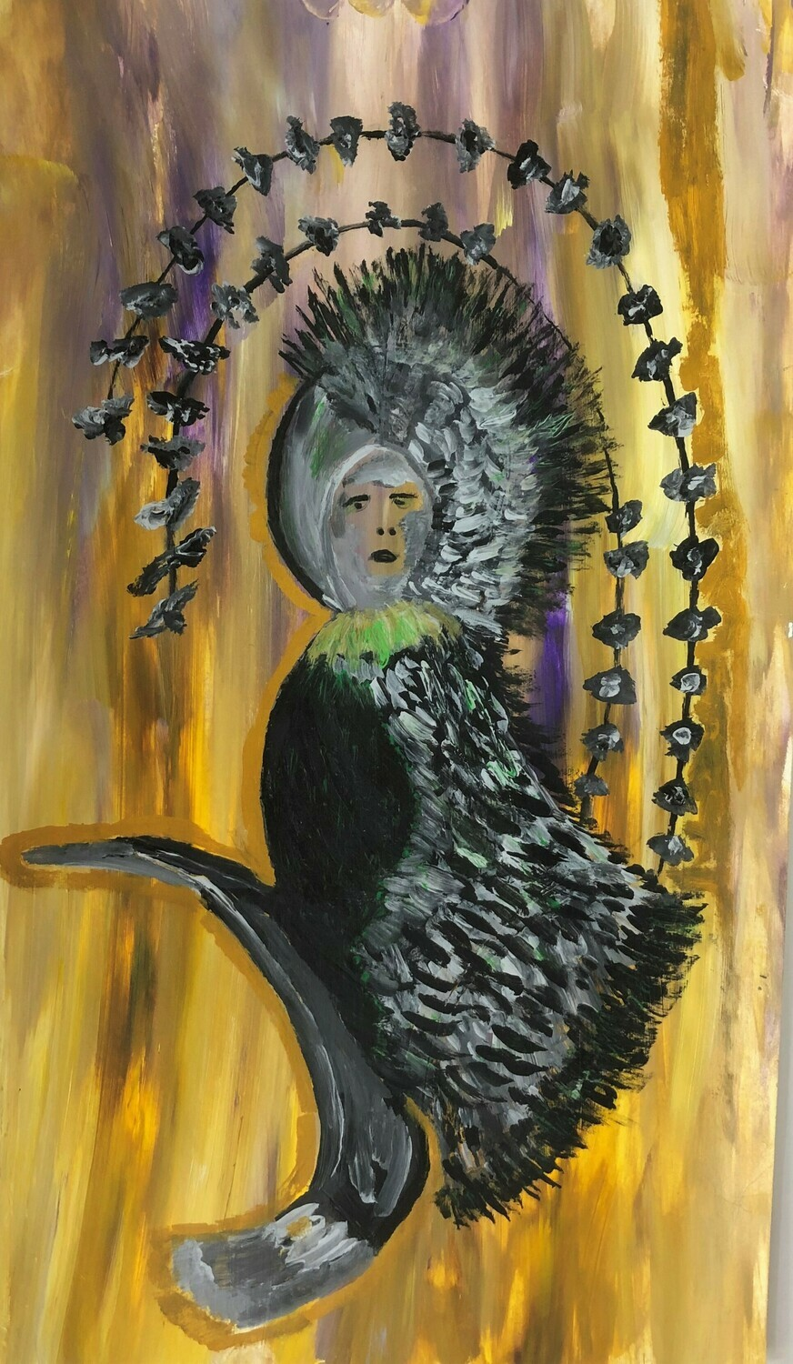
Bird Lady
Artist: Nadine Baldwin

Slide 11
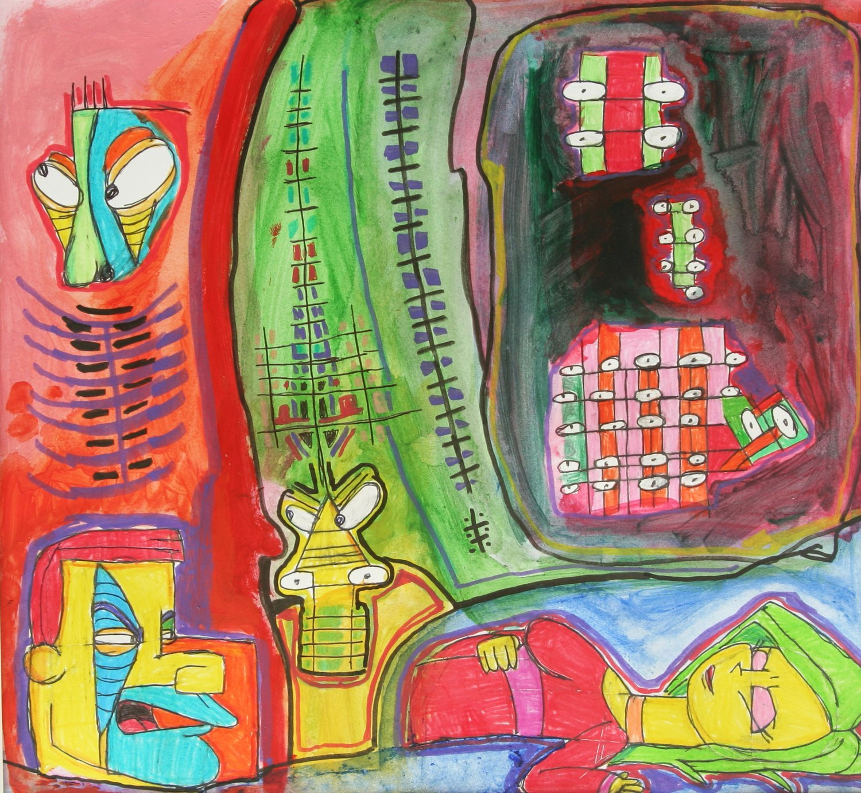
Dreaming Woman
Artist: Zach Manuel

Slide 12
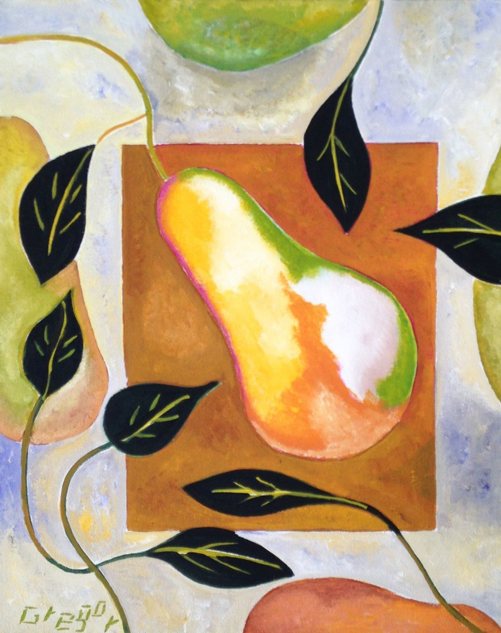
Amidst Falling Leaves
Artist: Gregg Bannister

Slide 13
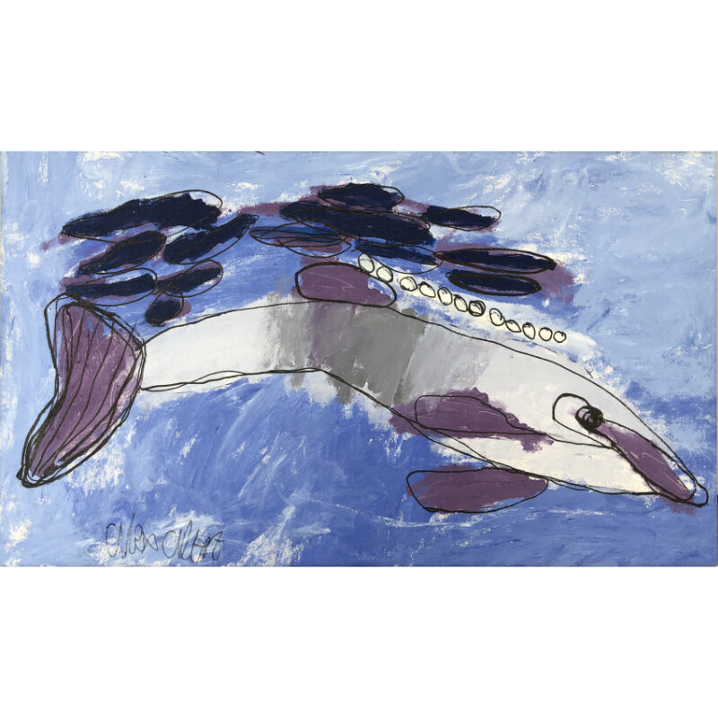
The Dolphin
Artist: Alex Albert

Slide 14
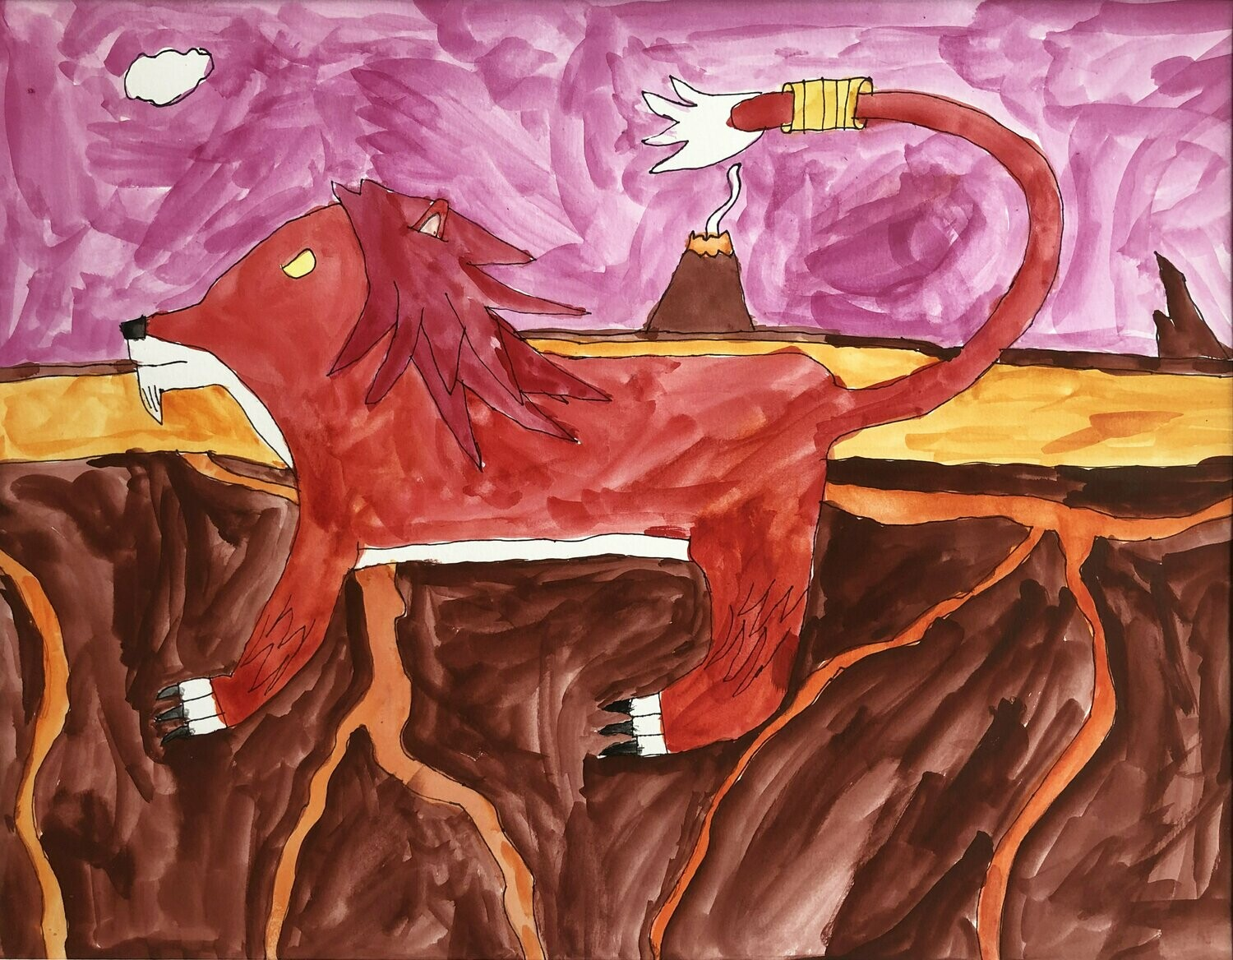
Fire Lion
Artist: Jeremy Foster

Slide 15
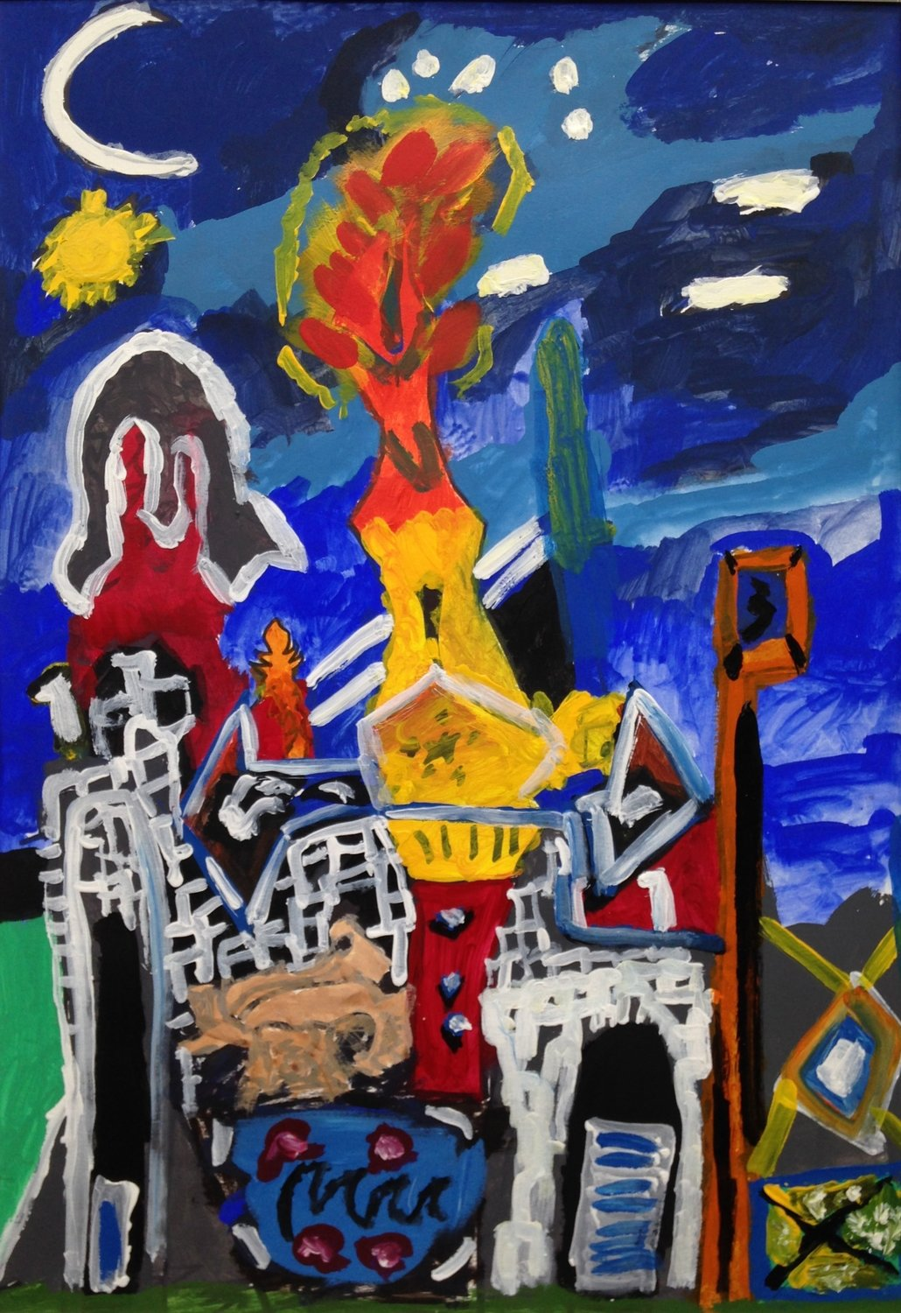
Transformation
Artist: Seth Jackson

Slide 16
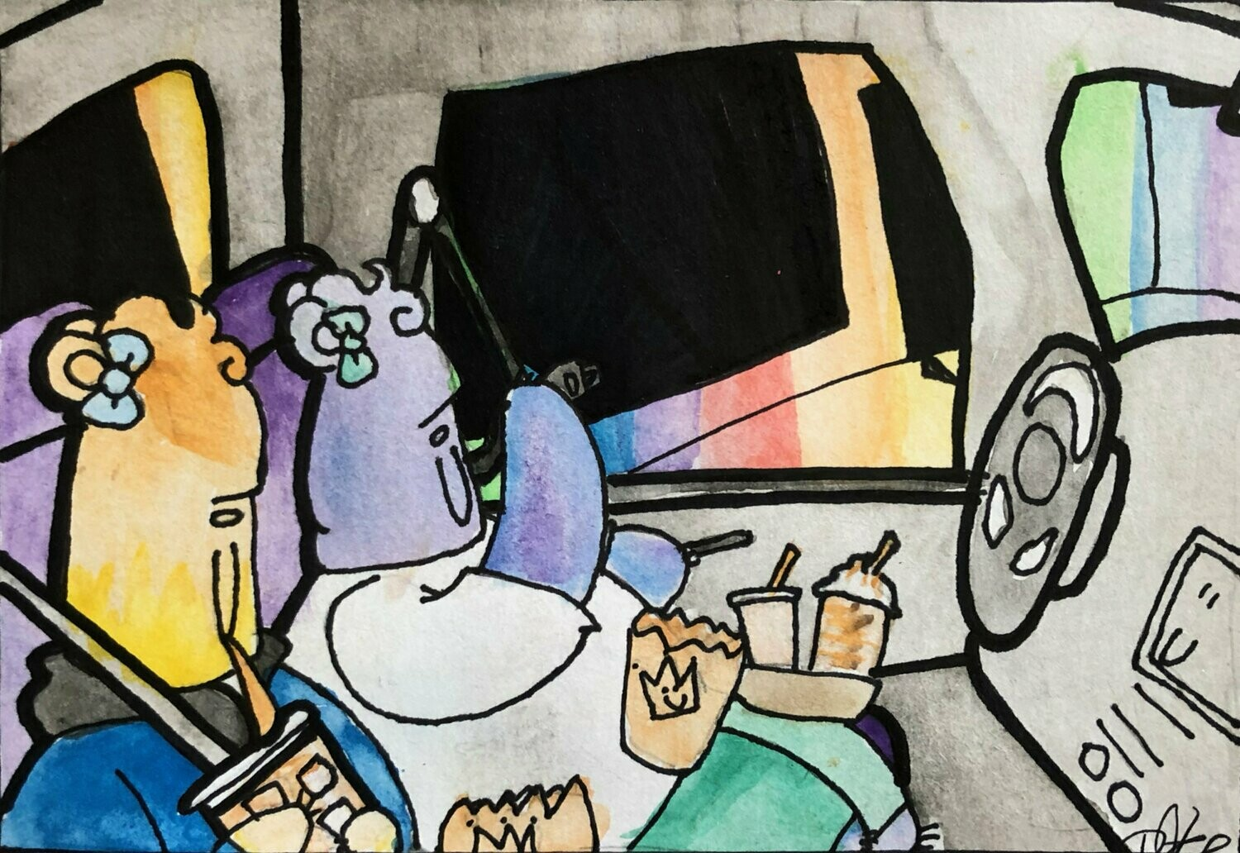
BFF Burger King Art Teachers
Artist:
Dasha Kalumuck

Slide 17
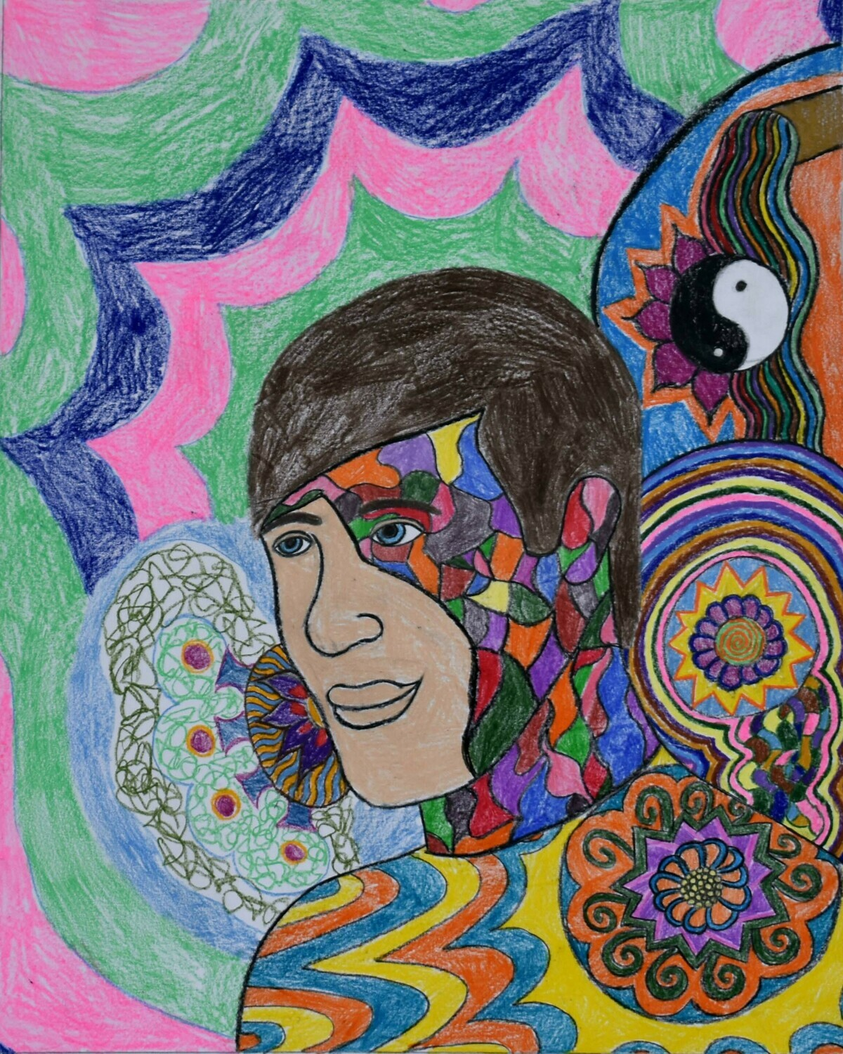
Shinny Happy People
Artist: Gemma Frost

Slide 18
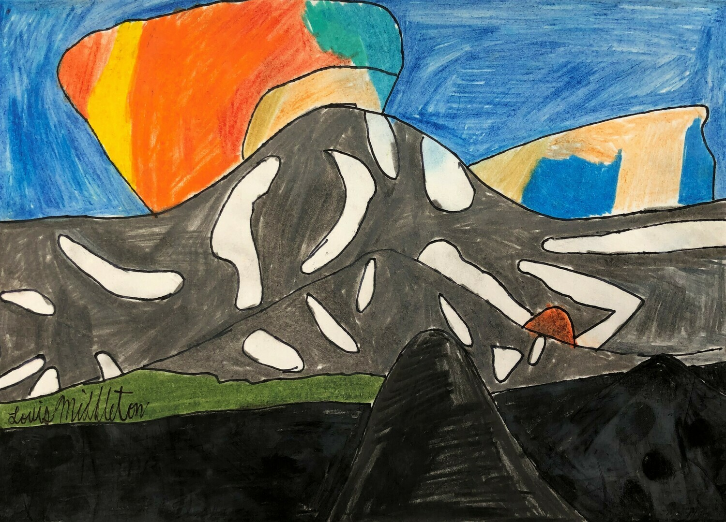
Mt. Rainier Lenticular Cloud
Artist: Louis Middleton

Slide 19
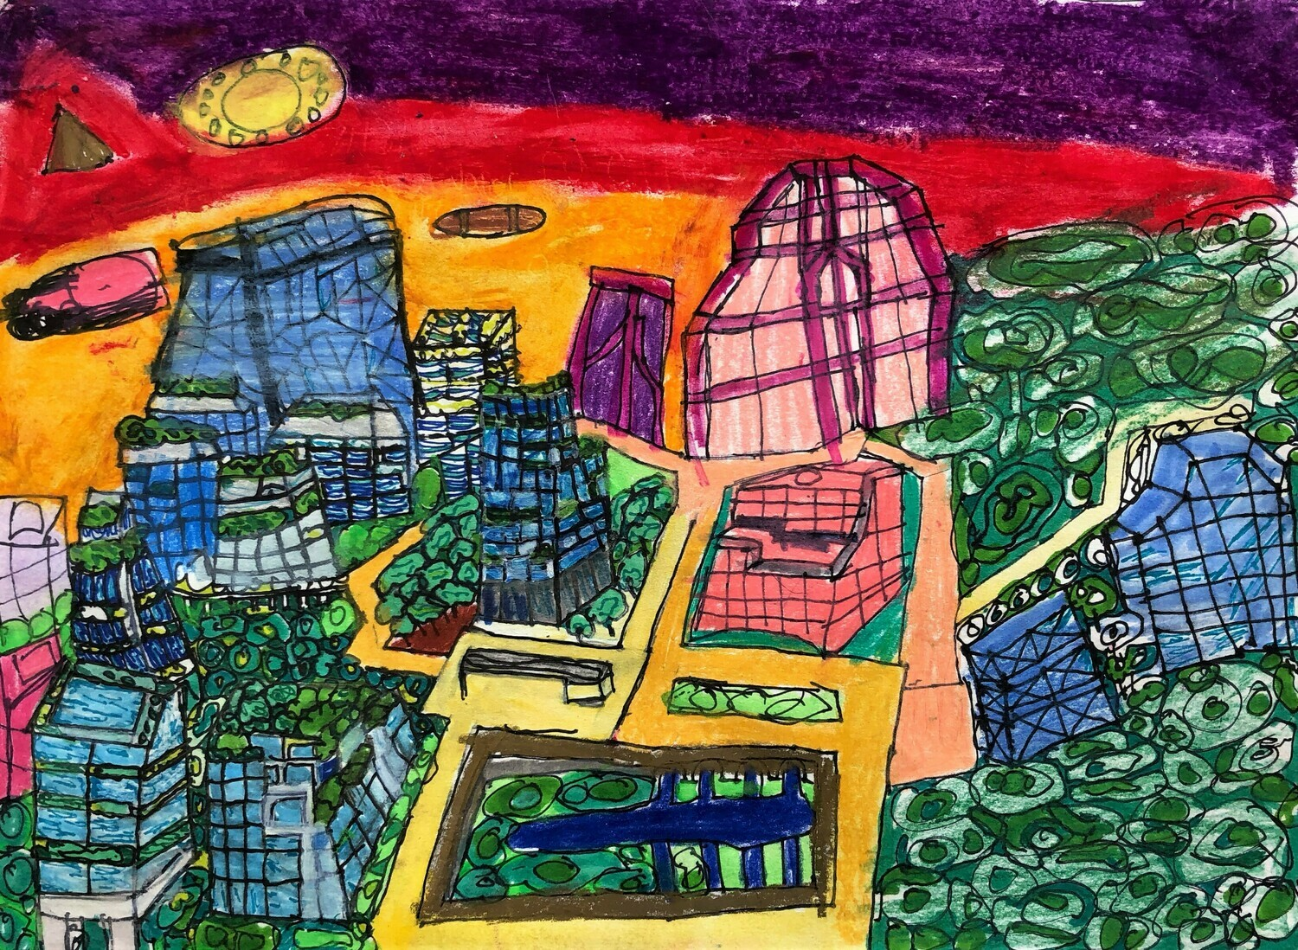
City of Valor
Artist: Katelynn Herty

Slide 20
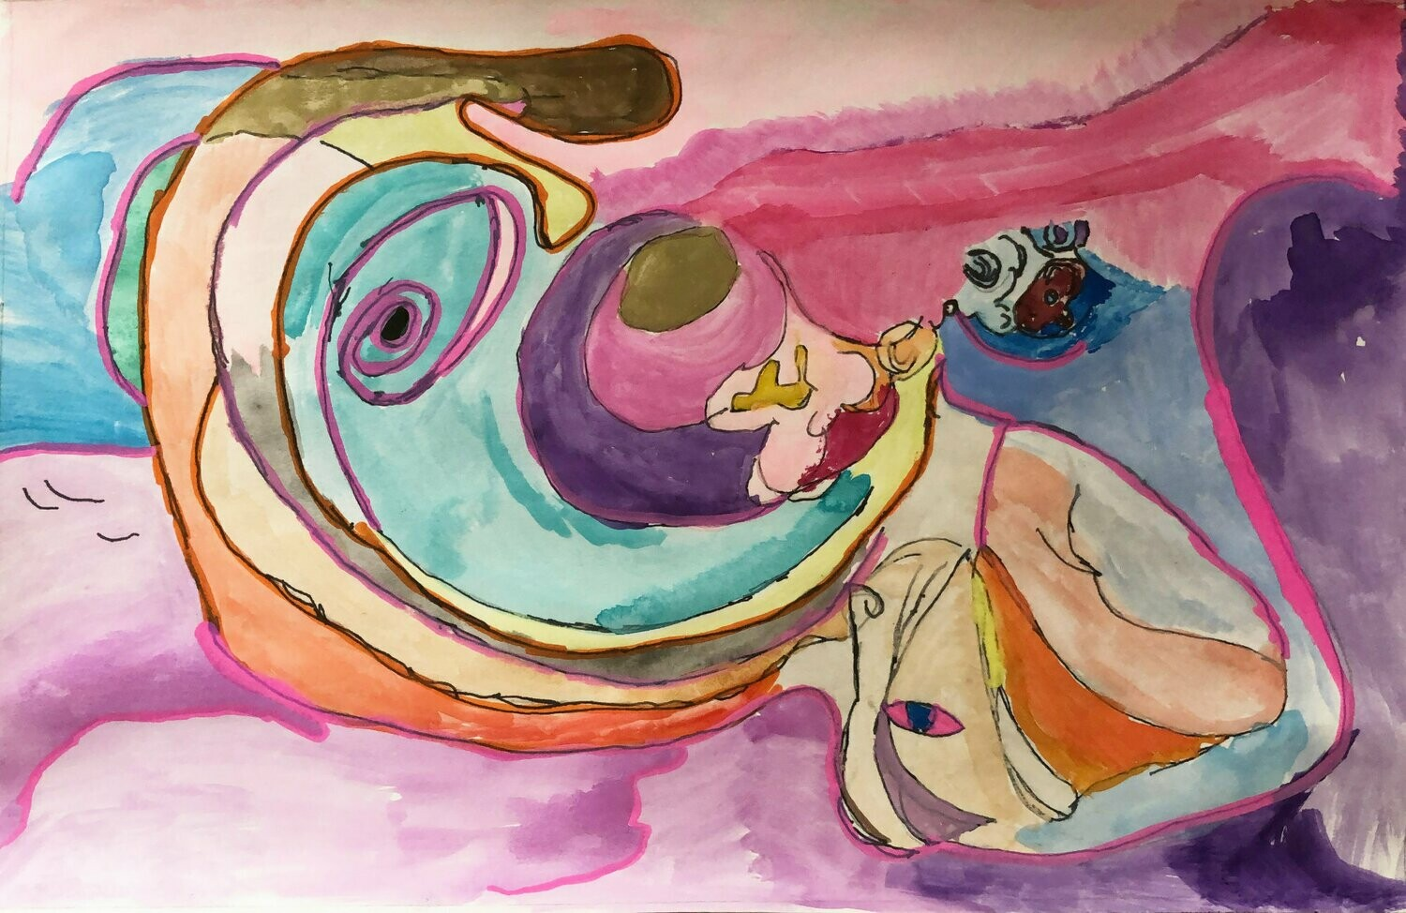
Southwestern Palette
Artist: Chuck Fisher

Slide 21
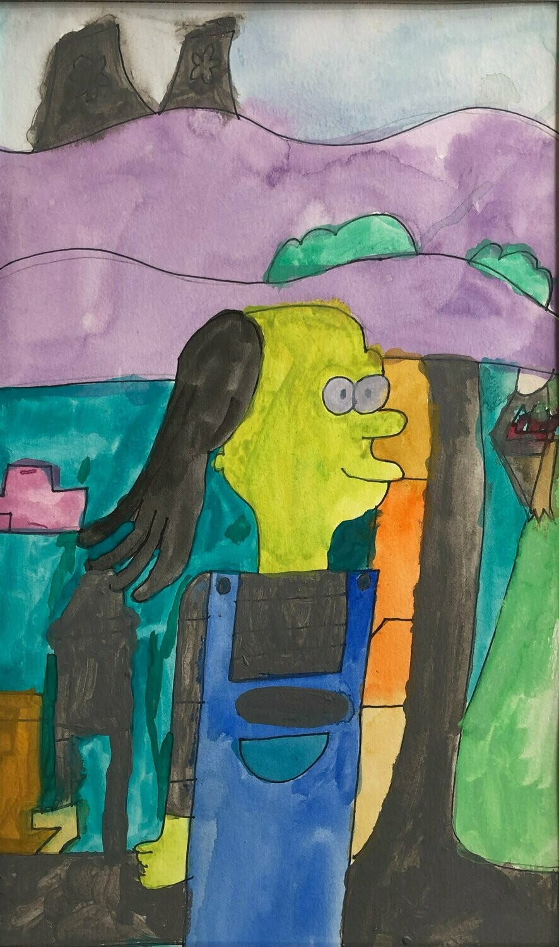
Self Portrait
Artist: Jules Hinmon

Slide 22
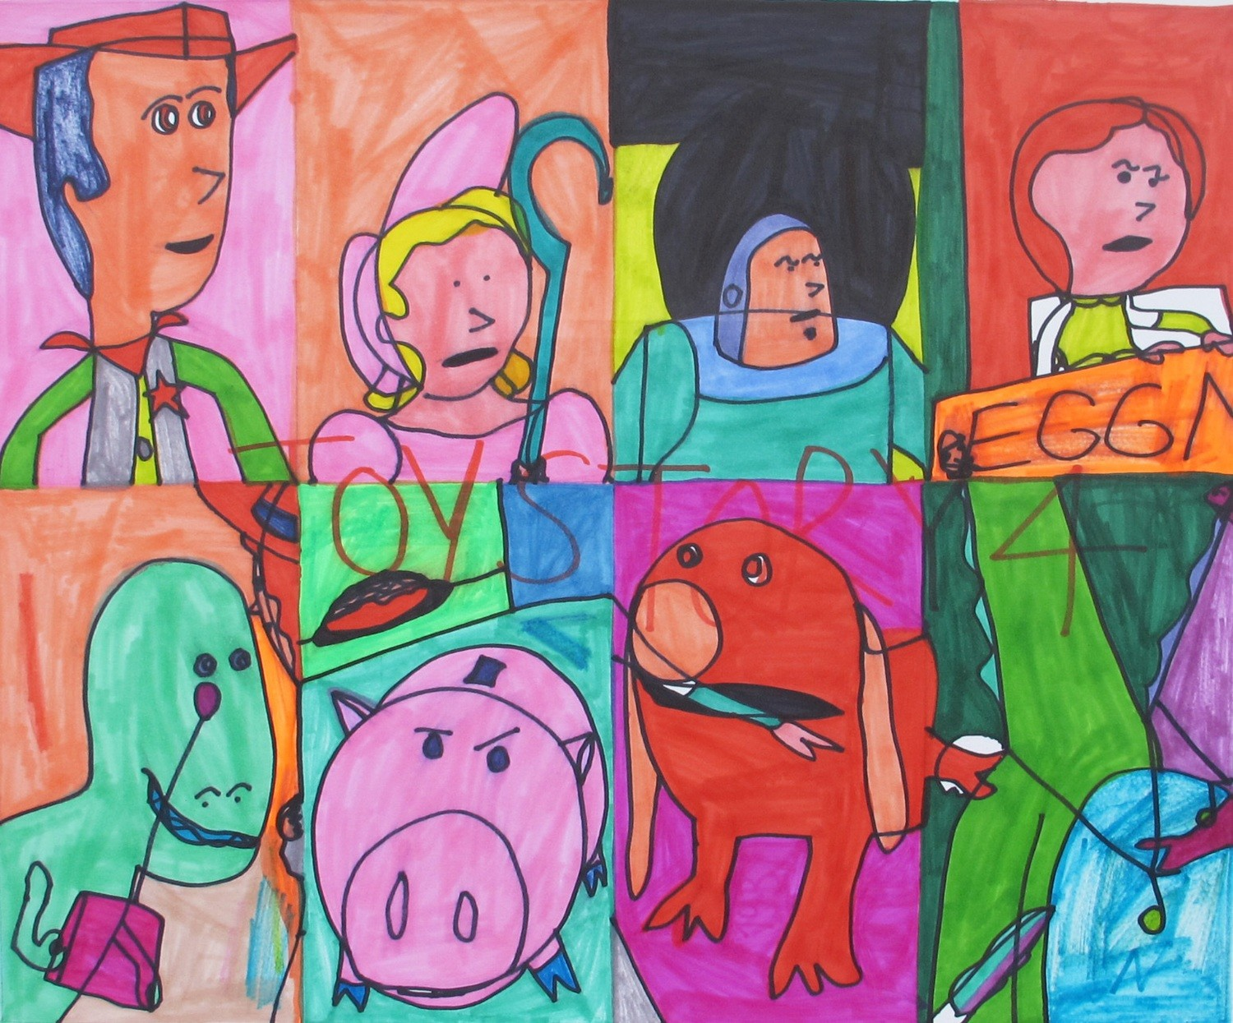
Toy Story Facial Expressions
Artist: Jimmy Wancowicz
Notes:
From top left to bottom right:
Eight segmented sections with “ToyStory 4” in red block letters in the center. Woody, against a pink background, wearing his western hat, vest and sheriff’s star. Little Bo-Peep, wearing a pink dress, against an orange background holding her blue staff. Buzz Lightyear is frowning against a black and yellow background. Jessie, a doll with red hair and a lime green dress “E-G-G and half of N”, against a red background. Rex, standing against an orange background, wearing a monocle. Hamm standing against a blue and green background. Slinky Dog, is red and holding a fish in his mouth, against a pink background. Lastly, a green dragon with a second purple neck.

Slide 23
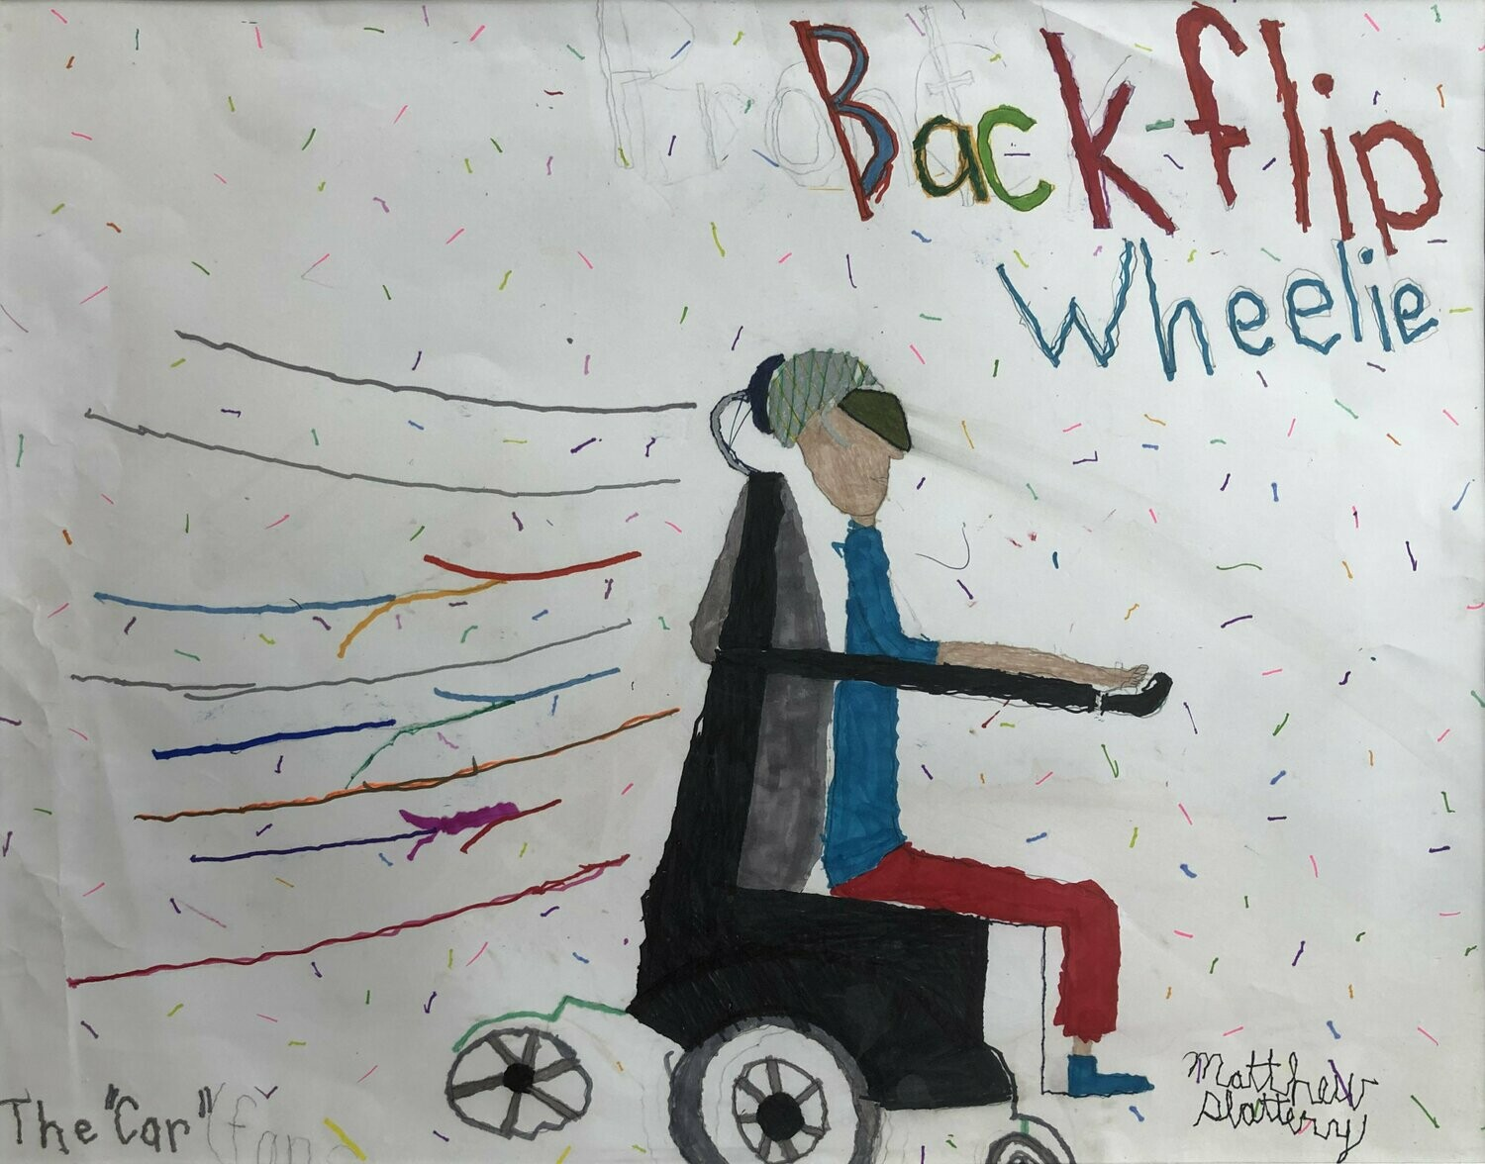
Back-Flip Wheelie
Artist: Matthew Slattery

Slide 24
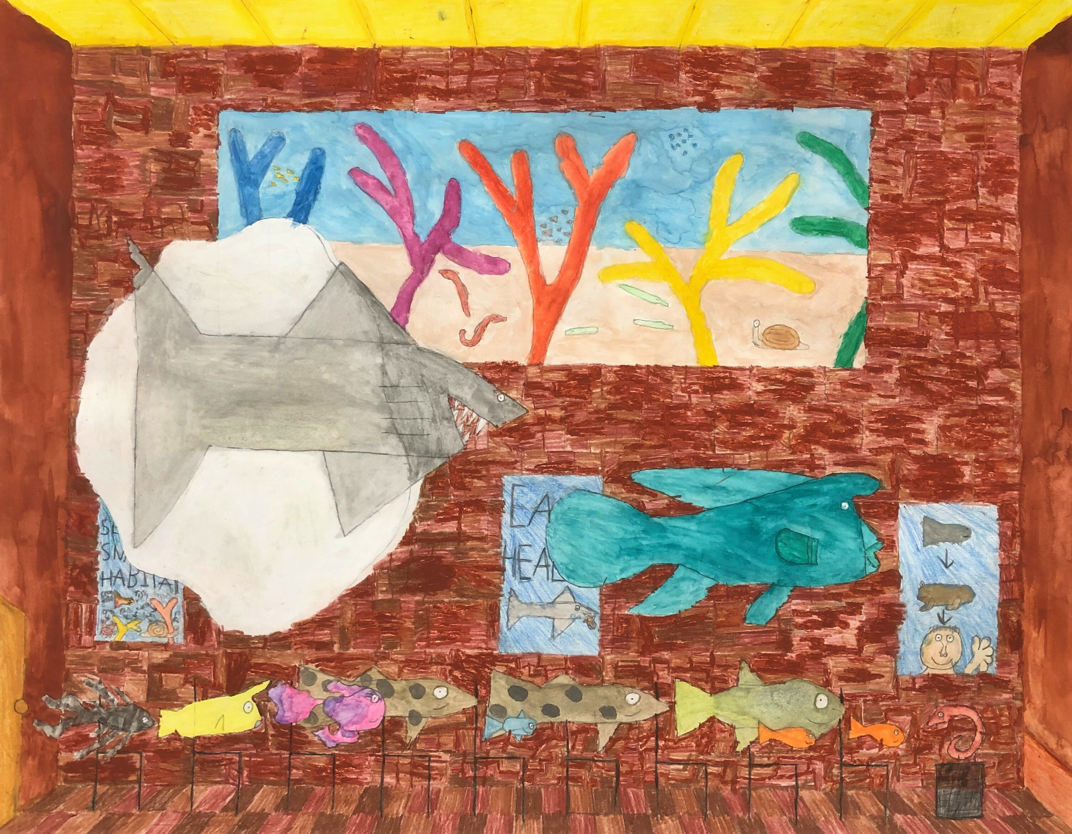
Fred’s School
Artist: Malcolm Slater

Slide 25
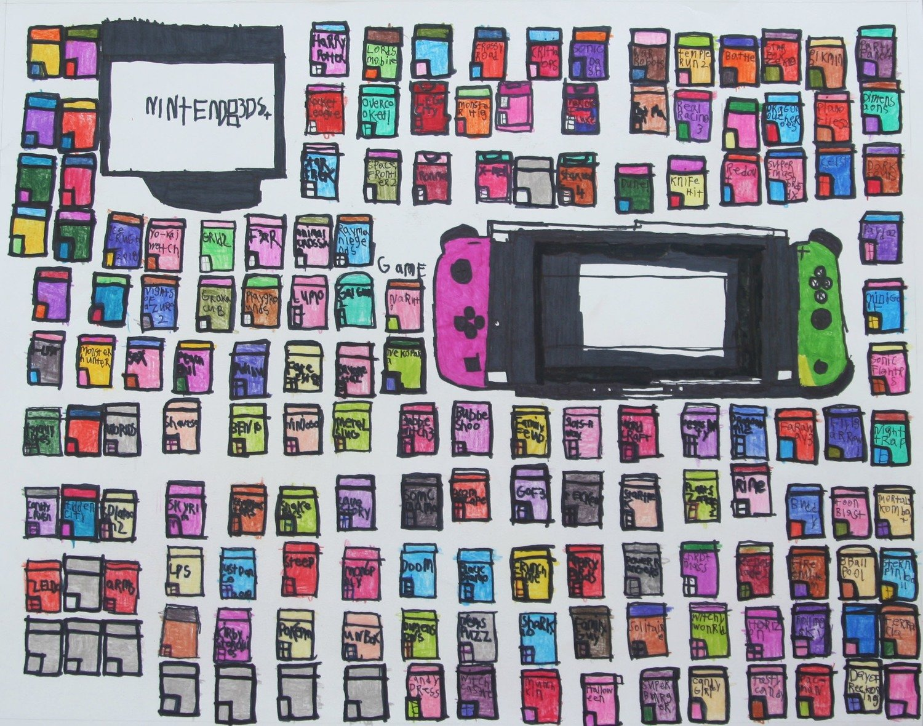
Videogames
Artist: Michael Vita

Slide 26
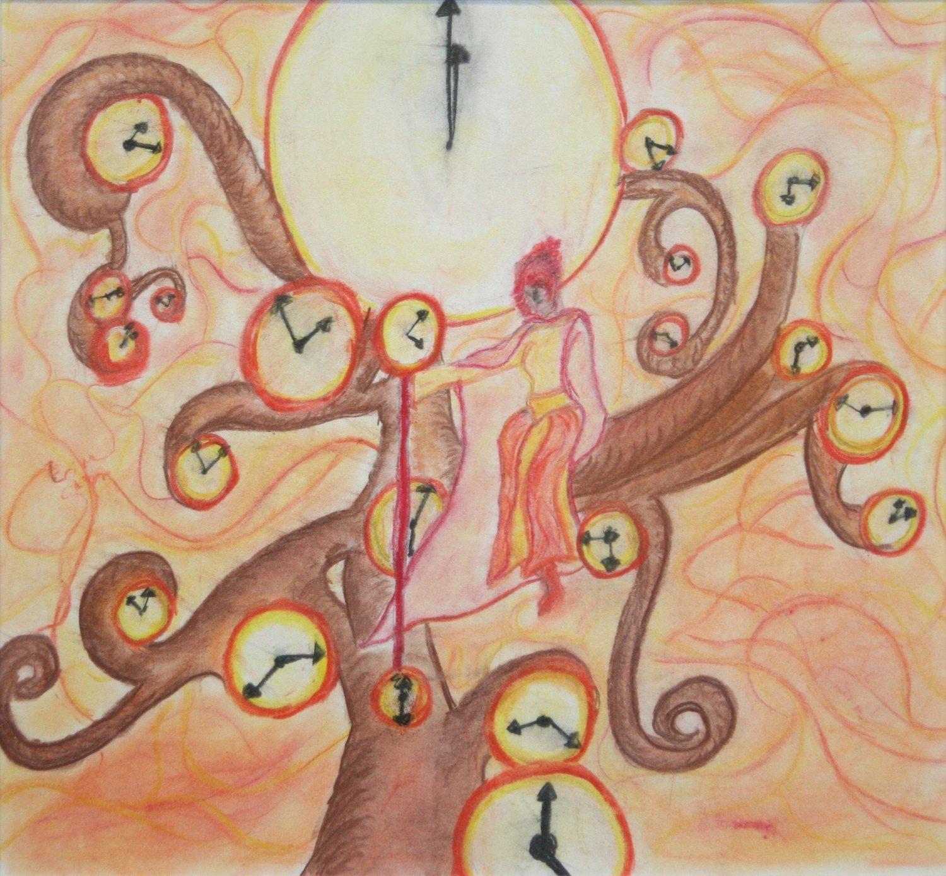
Incarnations of Time
Artist: Erika Clark

Slide 27
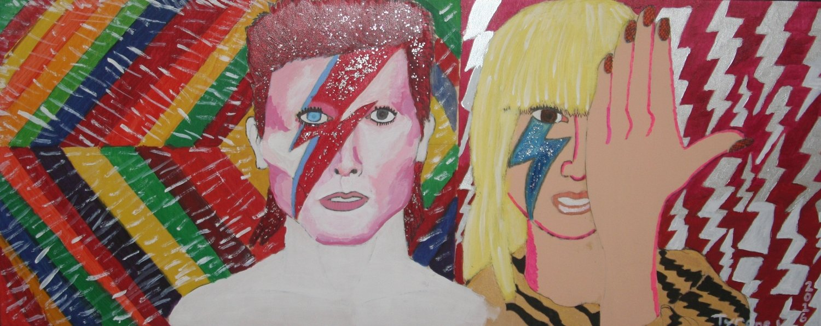
David Bowie Tribute with Lady Gaga
Artist: Tyrone Weedon

Slide 28
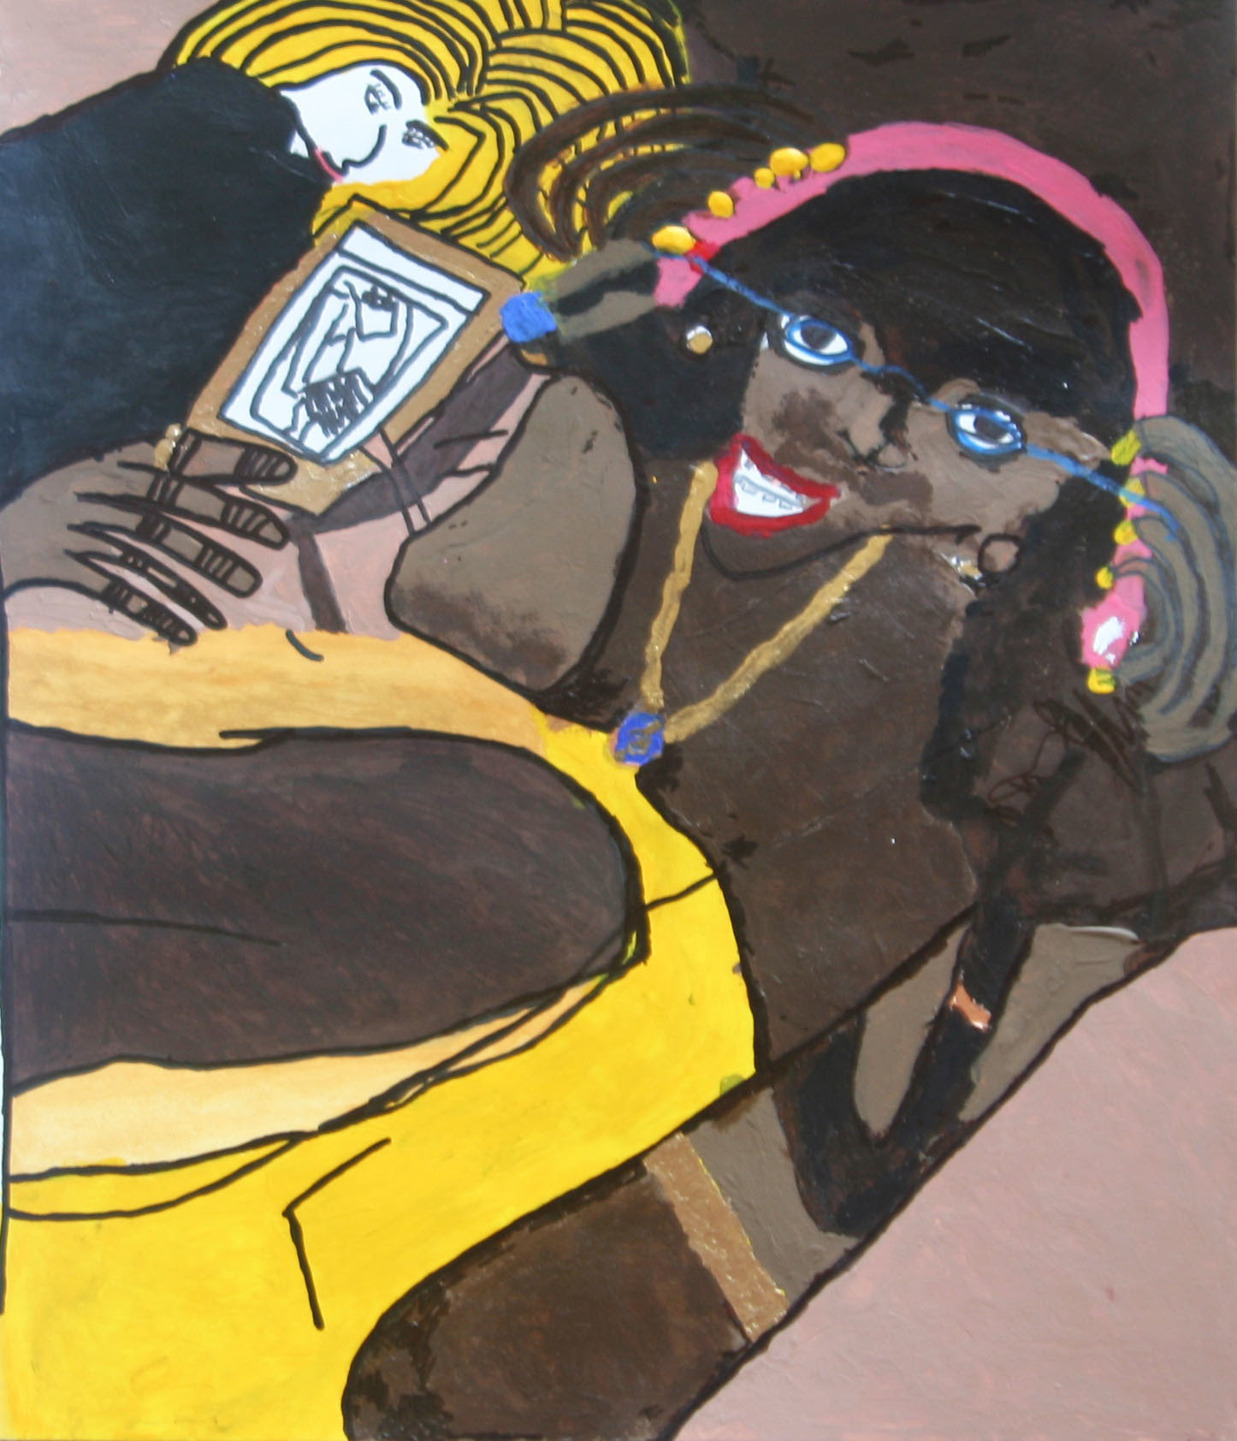
The World According to Gale
Artist: Donatavious Woody

Slide 29
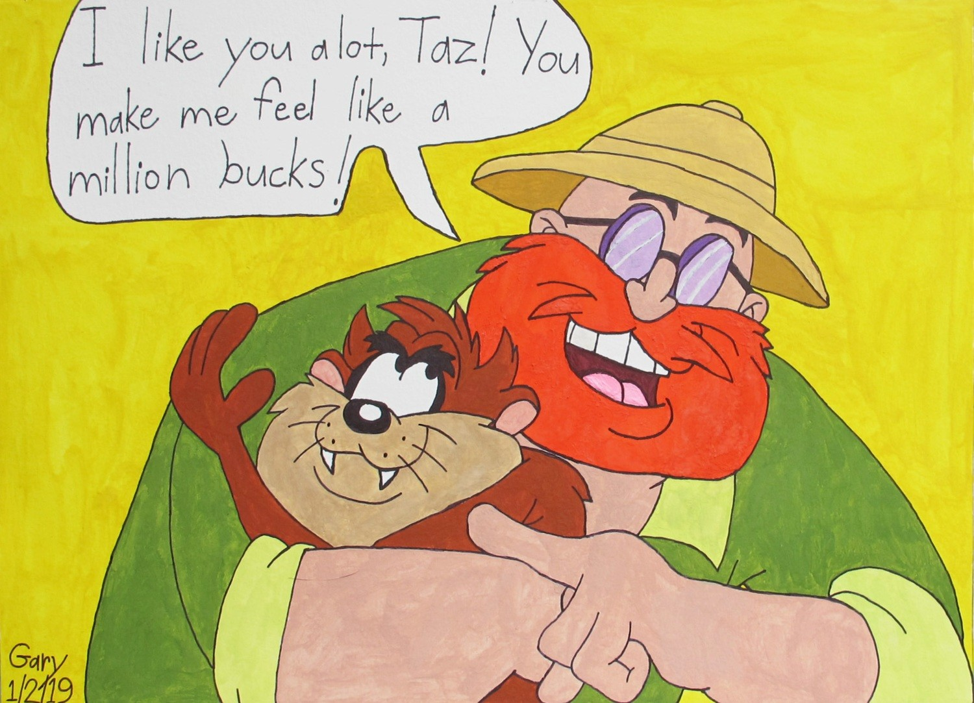
Taz and Bob
Artist: Gary Schmedes

