Slide 1
Moving ahead with PROMISE: Lessons learned from six model demonstration projects through the Promoting Readiness of Minors in Supplemental Security Income
Kelly Nye-Lengerman, Ph.D., MSW
Institute on Disability
University of New Hampshire

Slide 2
Background: SSI program & youth
Age 18 SSI redeterminations using adult eligibility criteria.
Eligibility is based in an inability to perform substantial gainful activity.
60% of child SSI recipients go on to receive SSI as adults.
Positive graduation, postsecondary education and employment outcomes have been difficult to achieve.
Long term dependence on SSI persists a national concern.
SSI youth and families face many challenges.

Slide 3
Purpose
Competitive grant awards
Six grants were awarded in FY2013 for 5 years to implement Model Demonstration Projects (MDPs) to promote positive outcomes for children between the ages of 14 and 16, when selected, who receive SSI and their families.
PROMISE aims to encourage new ways of providing support and to build an evidence base on the effectiveness of promising interventions and outcomes related to the transition from school to postsecondary education and competitive integrated employment.
The AUCD PROMISE TA Center was awarded in FY2014.
www.promisetacenter.org

Slide 4
PROMISE Federal Partners
PROMISE
U.S. Department of Education
U.S. Social Security Administration
U.S. Health & Human Services
Association for University Centers on Disabilities
(National Technical Assistance Center)
Mathematica
(National Evaluator)
U.S. Department of Labor
PROMISE Model Demonstration Projects (MDPs)
Notes:
Four federal agencies
U.S. Department of Education
U.S. Social Security Administration
U.S. Health & Human Services
U.S. Department of Labor
Flow from U.S. Department of Education are:
1. Association of University Centers on Disabilities (National Technical Assistance Center)
2. PROMISE Model Demonstration Projects (MDPs)
Flow from the U.S. Social Security Administration
1. Mathematic Policy Research (National Evaluator)

Slide 5
Research Design
Target Population: Youth, 14-16 years of age enrolled in the SSI program through the Social Security Administration, and their families.
Six grant awardees were required to recruit 13,172 participants for the study (all MDPs were required to recruit 2,000 participants , except CA – 3,172 participants); recruitment ended on 4.30.16 and all MDPs met or exceeded their enrollment targets (total enrollment- 13,444/102%).
Experimental Research Design: RCT used to test interventions to predict positive outcomes for SSI eligible youth. The control group continues to receive typical services available to them in their state.

Slide 6
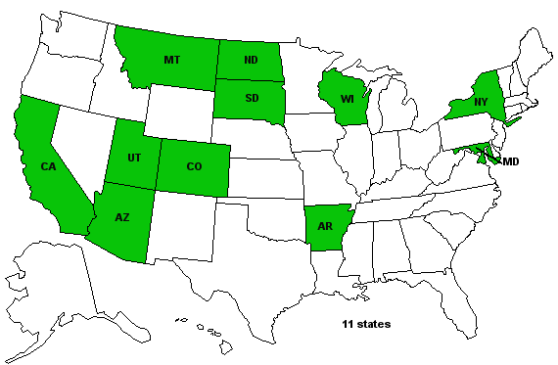
Map and Logos of PROMISE

Slide 7
PROMISE MDP Core Features
Requirements
Develop partnerships with multiple state agencies and organizations
Provide services and supports which include:
case management
benefits counseling and financial capability services
career and work-based learning experiences including paid employment in integrated settings
parent training and information
Complete Participant outreach and recruitment
Provide technical assistance and training to include professional development for all stakeholders

Slide 8
Lessons Learned Across PROMISE

Slide 9
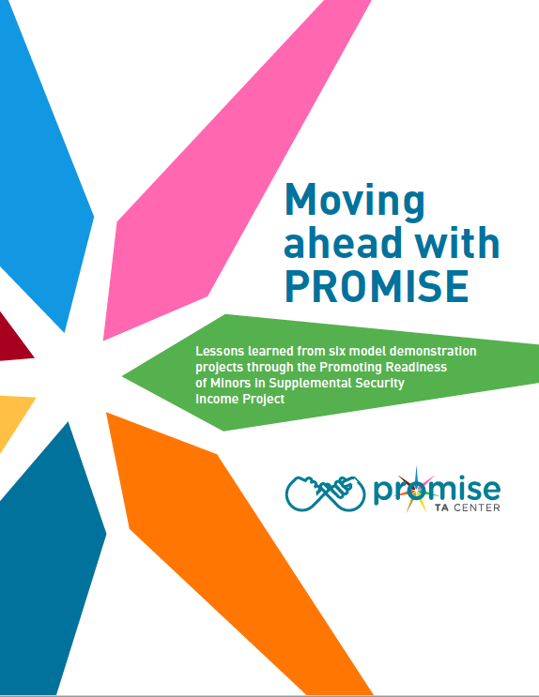
Lessons Learned Report
Accessible PDF and “read it to me” version
Policy context for PROMISE
MDP profiles
Lessons on partnerships & core services

Slide 10
PROMISE Lessons: Partnership
Shared values and beliefs regarding the capacity of SSI youth and families to achieve positive outcomes need to be articulated.
Partnerships are essential to achieving results, however, the complexity of managing these partnerships is challenging.
Memorandums of Understanding (MOUs) and interagency agreements are useful in delineating initial aspects of shared agency responsibility, but they have limitations in how they are used on an ongoing basis.

Slide 11
PROMISE Lessons: Partnership cont.
Allowing for flexibility in the development and implementation of state action plans is a necessary and valued strategy to address specific state, regional, and local needs.
Sharing information about SSI youth and families across agency boundaries remains a significant challenge.

Slide 12
PROMISE Lessons: Core Services
Maximizing the capacity of existing services to serve SSI youth and families is an important step toward the sustainability of improved service delivery.
Comprehensive training and technical assistance are necessary in supporting multidisciplinary approaches in serving SSI youth and families.

Slide 13
PROMISE Lessons: Core Services cont.
3. A comprehensive, holistic case management service model is critical in achieving active and sustained SSI youth and family engagement.
4. Transition planning needs to begin early for SSI youth and families, not only to address the youth’s educational needs, but also to plan and provide work experiences, develop social and financial literacy skills and positive behaviors, and develop skills for independent living.

Slide 14
PROMISE Lessons: Core Services cont.2
When youth have the primary voice in transition planning and decision-making, they are more likely to be committed to future education and employment goals.
Ensuring culturally responsive approaches is essential in addressing the diversity of SSI youth and families within the PROMISE states.
7. Providing accurate information to SSI youth and their families on SSA work incentives and community services and supports requires an interdisciplinary and collaborative approach.

Slide 15
Continued conversations: Moving beyond PROMISE

Slide 16
Moving beyond PROMISE
The role of a case manager or navigator that works directly with families to share information and coordinate education, employment and related services was found to be important in engaging SSI youth in work based learning experiences.
Notes:
The five key services are listed in green text are: Case management, benefits counseling, career and work-based learning experiences, parent/guardian training and information, and Youth self-determination training.

Slide 17
Moving beyond PROMISE cont.
Early intervention requires that special education staff have knowledge on whether a student is currently an SSI recipient.
Information needs to be broadly shared with parents on the SSI redetermination process, the value and importance of early work experiences for their child with a disability, and the availability of work incentives that support workplace participation.

Slide 18
Moving beyond PROMISE cont. 2
Vocational rehabilitation’s role in providing Pre-Employment Transition Services should universally include youth earlier than age 16. The current IDEA transition service requirements do not prohibit serving students with disabilities younger than age 16, but this needs to be emphasized more to VR, special education staff, and parents as a possibility.

Slide 19
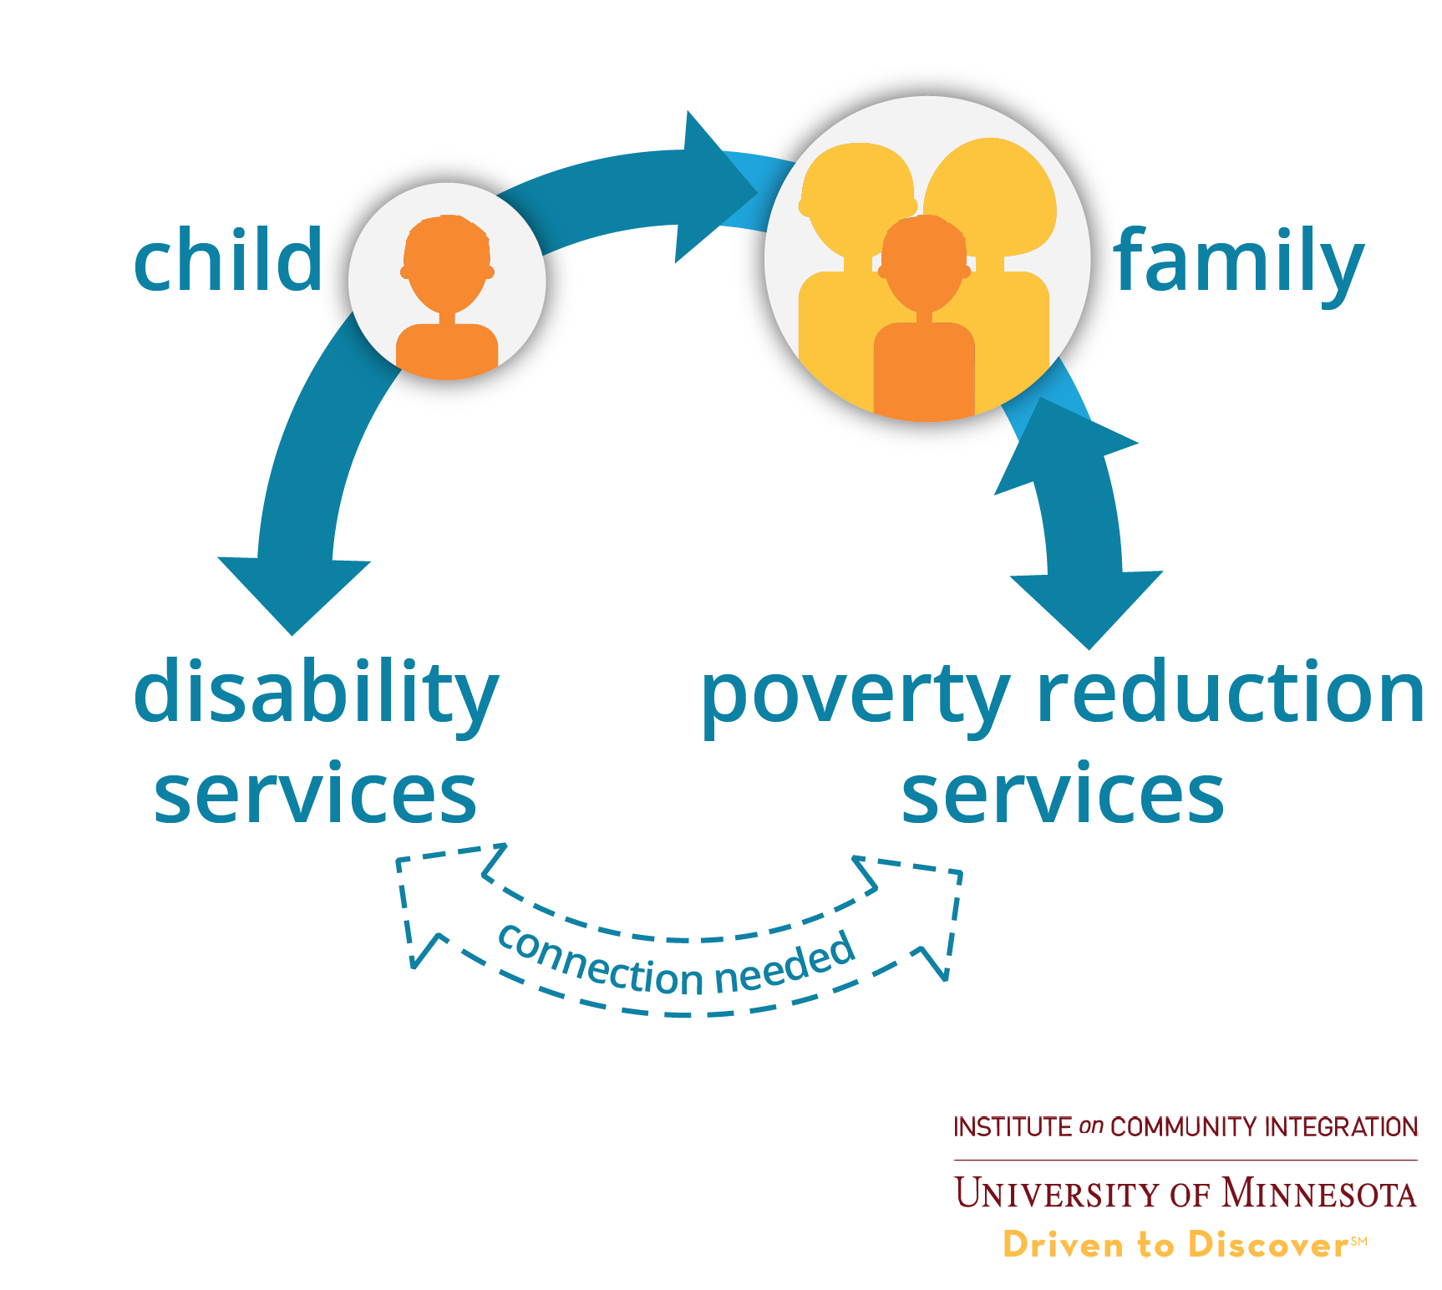
Moving beyond PROMISE cont.3
PROMISE activities further articulate the deep connection between disability and poverty, and the importance of families to be able to meet basic needs.
Notes:
KELLY

Slide 20
Between the lines take aways
Improved integration (policy & service) of service system
Data integration for reporting, outcomes, accountability & impact
Cultural & linguistic competency that is trauma informed at all levels
Support and engagement of family unit to benefit youth
Case managers are essential for system navigation
Expectations and messaging matter

Slide 21
Additional Reading on PROMISE
Open source Journal of Vocational Rehabilitation (JVR) PROMISE Special Issue
Open Source Career Development and Transition for Expectational Individuals (CDTEI) Special PROMISE Issue
Mathmatica Policy Research Reports and findings
Social Security Administration Demonstrations

Slide 22
Contact information
Kelly Nye-Lengerman, Ph.D., MSW
University of New Hampshire
Kelly.nye@unh.edu
PROMISE TA Center staff: John Tschida, Denise Rozell, &
Kai A. Gunty
TA Center Consultant: David R. Johnson
PROMISE TA Center Project Officer: Corinne Weidenthal
This presentation is based on work supported, in whole or in part, by funding from the U.S. Department of Education, Office of Special Education Programs (OSEP) to the Association of University Centers on Disabilities (AUCD) for the PROMISE Technical Assistance Center (H418T140002), and subcontracted to the University of Minnesota, Institute on Community Integration. The contents of this report do not necessarily represent the policy or opinions of the U.S. Department of Education or Offices within it. Readers should not assume endorsement by the federal government.

