Slide 1
Office of Disability Employment Policy: Federal Efforts to Improve Employment Outcomes
July 28, 2021

Slide 2
Presenter
Rob Trombley
Sr. Policy Advisor, Youth Team
Office of Disability Employment Policy
U.S. Department of Labor

Slide 3
Presentation Objectives
Provide an overview of the Office of Disability Employment Policy Youth Team
Describe ODEP’s new CAPE-Youth Center
Provide updates on Inclusive Apprenticeships
Describe other ODEP Youth team initiatives

Slide 4
ODEP
Part of U.S. Department of Labor
Non-regulatory
Promotes policies and coordinates with employers and all levels of government to increase workplace success for people with disabilities
Mission: To develop and influence policies that increase the number and quality of employment opportunities for people with disabilities
dol.gov/odep

Slide 5
Administration's priorities
Ensure a disability-inclusive COVID response and recovery
Promote racial and social equity in disability policy and programs
Support workers with mental health conditions and promote mental health-friendly workplace policies and practices
Expand opportunities for training and employment in clean/green energy and other high-growth industries
Help youth with disabilities prepare for and succeed in employment in post-pandemic era

Slide 6
Office of Disability Employment Policy (ODEP) Priorities
Analyze, Research and Evaluate
Develop Implementation Tools
Develop Policies
Conduct Outreach
Collaborate
Provide Technical Assistance

Slide 7
ODEP Policy Teams
Employment-Related Support Policy
Workforce System Policy
Employer and Workplace Policy
Youth Policy

Slide 8
Youth Team Initiatives
Youth Transition
CAPE Youth Center
Inclusive Apprenticeships
SSI Youth Solutions
Guideposts for Success
Federal Partnerships

Slide 9
Center for Advancing Policy on Employment for Youth (CAPE-Youth)
A consortium of Partners include the Council for State Governments, University of Massachusetts, and Cornell
Website: Capeyouth.org
Key Focus Areas
Career Pathways
Systems Coordination
Professional Development
Covid-19 Resources

Slide 10
Guideposts for Success
School-Based Preparatory Experiences
Career Preparation and Work-Based Learning Experiences
Leadership Development and Leadership
Connecting Activities (housing, transportation, health care, etc.…)
Family Involvement and Supports
https://capeyouth.org/guideposts-for-success/

Slide 11
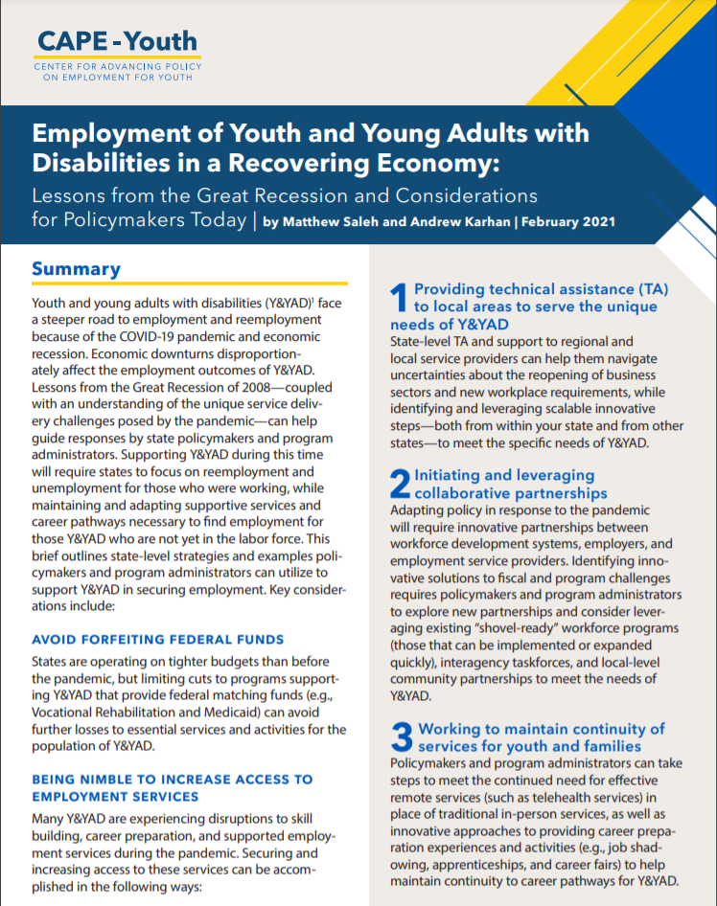
Issue Brief: Employment of Youth and Young Adults with Disabilities in a Recovering Economy
Avoid forfeiting federal funds
Be nimble to increase access to employment service
Initiating and leveraging collaborative partnerships
Providing technical assistance to serve needs of youth
Working to maintain continuity of services for youth and families
Recognizing need for effective remote service delivery
Employment of Youth and Young Adults with Disabilities in a Recovering Economy-Brief

Slide 12
CAPE-Youth Research Initiatives: COVID-19 Scan
While youth with disabilities are not inherently at higher risk for contracting COVID-19, youth with disabilities may be disproportionately affected by the disruption of services, including receiving appropriate special education, related services, and accommodations, among other programs and services.
Cape Youth COVID Scan
Notes:
If asked:
The CSG team utilized online databases and individual state agency websites to collect the following:
Variables to be Collected
State
Date Created
Topic
Title/Name
Summary (Clearly state how it relates to the category it is under)
Age Focus
Disability Focus
Statewide/Regional
Operating Entity
Link
If it is a bill or executive order:
Type
Number
Name
Status
Date Introduced
Sponsor/Co-Sponsor (Party Affiliation)
Data Sources/ State Agencies
Department of Education
Department of Health and Human Services
Department of Workforce/Labor
Office of Mental Health
Office of Vocational Rehabilitation
State Community Colleges
NCSL Disability Employment Database
Drive Site
Work Matters- Preparing for Work
Fiscal Note

Slide 13
CAPE-Youth Research Initiatives: COVID-19 Scan cont.
CAPE-Youth conducted a national state by state scan on state level responses to COVID-19 that focus on mitigating the impact of COVID-19 on the transition of youth and young adults with disabilities. Current areas of focus include:
Assistive Technology
Distance Learning
Family Engagement
Individualized Education Programs
Mental Health
Telehealth
Transition Services

Slide 14
Upcoming CAPE-Youth Work- Research
Research and Development
Mixed methods study on collaboration in WIOA systems
Qualitative research on professional development for youth service providers
Study on Pre-employment Transition Services
Scan of State programs and polices for youth and young adults with disabilities

Slide 15
Upcoming CAPE-Youth Work: COVID-19
Sharing State work and resources on key topics for youth with disabilities
Developing brief on the use of Trauma Informed Care in the Workforce System as we recover from the pandemic
Sharing other federal resources from our federal partners including the Federal Partners in Transition network.

Slide 16
Apprenticeship Inclusion Models (AIM)
ODEP sponsored work to research, develop, test, and evaluate innovative strategies in existing apprenticeship programs that provide skills training to people with disabilities.
Website: https://www.dol.gov/agencies/odep/program-areas/individuals/youth/inclusive-apprenticeship

Slide 17
AIM Covid-19 Webinar
Webinar: Emerging Lessons for Inclusive Apprenticeship Programs: Managing Through the COVID Crisis and Beyond
In this webinar, AIM experts share insights for how inclusive apprenticeship programs are responding to the current crisis and planning for resilient programs in the future.
https://spra.webex.com/spra/onstage/g.php?MTID=e6d487c1aa1d31642b80659529381bb45

Slide 18
AIM- Briefs
Connecting Ticket to Work and Apprenticeships
Emerging Lessons for Inclusive Apprenticeship Programs: Managing Through the COVID-19 Crisis and Beyond
Funding Inclusive Apprenticeships: Strategies for Braiding, Blending, and Aligning Resources
Strengthening Supports for People with Disabilities in Pre-Apprenticeships Through Policy, Design, and Practice
Using Universal Design for Learning in Apprenticeship

Slide 19
Community Colleges
ODEP funded two model demonstration projects to improve recruitment, retention, and credential attainment for Youth and Young adults with disabilities.
Universal Pathways to Employment Project at Pellissippi State Community College
Onondaga Pathways to Career at Onondaga Community College
https://capeyouth.org/blog-series-inclusive-community-college-career-pathways/

Slide 20
Federal Partners in Transition
FPT was formed in 2005 to improve interagency policy and service coordination to support all youth, including youth with disabilities, in successfully transitioning from school to adulthood
The partnership is led by Jennifer Sheehy, Deputy Assistant Secretary for Office of Disability Employment Policy for Department of Labor.
Some Participants include:
Department of Education
Department of Health and Human Services
Department of Labor
Social Security Administration
Department of Justice

Slide 21
SSI Youth Solutions
ODEP funded 12 Subject Matter experts to propose 12 policy, program, or service ideas to promote the transition outcomes of youth SSI recipients. Papers focused on:
Training and Apprenticeships, Transition Supports, and SSI Criteria
Case Management
Disability Employment Curricula and Connecting to Postsecondary Education
Websites for presentations and Papers and previous ODEP work:
https://www.mathematica.org/features/ssi-youth-solutions-conference
https://www.mathematica.org/projects/initiatives-to-improve-adult-outcomes-and-employment-opportunities-for-young-recipients-of-ssi

Slide 22
Contact Information
Robert Trombley
Trombley.Robert.f@dol.gov

