Slide 1
Employment for People with Disabilities: Translating Evidence Amid Crisis
People with Intellectual and
Developmental Disabilities
are Critical Frontline Workers

Slide 2
Recent headlines
Notes:
Disability advocates call for protection of the most vulnerable during COVID-19 pandemic (13/05/2020);
Pandemic heightens vulnerabilities of persons with disabilities (12 May 2020);
People with intellectual disabilities are being hit hard by COVID-19;
COVID-19 infections and deaths are higher among those with intellectual disabilities (June 9, 2020)

Slide 3
What are the Reasons for Increased Vulnerability?
Food Insecurity
Lack of access to healthcare/testing
Inadequate Safety Education
Social Isolation
Underlying Medical Conditions

Slide 4
Impulse is to Protect and Shelter
Panic is neither warranted nor helpful
Withdrawal from employment can increase social isolation
Don’t disregard the risk, but, instead, produce practical solutions to minimize risk

Slide 5
CDC Guidance on COVID-19 and Disability
Most people with disabilities are not inherently at higher risk for becoming infected with or having severe illness from COVID-19.
All people seem to be at higher risk of severe illness from COVID-19 if they have serious underlying chronic medical conditions like chronic lung disease, a serious heart condition, or a weakened immune system.
https://www.cdc.gov/coronavirus/2019-ncov/need-extra-precautions/people-with-disabilities.html

Slide 6
Equal Employment Opportunity Commission
“…an employee’s medical condition is not considered a direct threat to themselves if the employer can reduce or eliminate the threat through a reasonable accommodation.”
https://www.employmentlawworldview.com/eeoc-provides-updated-guidance-on-return-to-work-issues-addressing-accommodations-for-employees-with-covid-19-vulnerabilities-us/

Slide 7
Employment is Key in Decreasing Vulnerability
Increased income reduces food insecurity
Employment comes with access to health insurance
Employers provide safety education and equipment
Community engagement and inclusion is increased through employment
Medical vulnerabilities can often be accommodated in the workplace

Slide 8
Parent Education
Recognize impulse to protect and shelter
Help parents consider and evaluate all risks
Understand balance of risks and benefits of work
Don’t disregard the risk, but, instead, produce practical solutions to minimize risk

Slide 9
Identify Training and Employment Opportunities Resulting from COVID-19
Decreased Capacity combined with Increased Regulation
Restaurants and Retail:
Reduced seating or number of customers in store
New disinfection protocols are required
Income is reduced
Grocery Stores and Distribution Centers:
Difficulty maintaining inventory
Need help with materials handling
Hospitals and Retirement Communities
Surface sterilization
Screening incoming patients, guests, and employees

Slide 10
Essential Workers at Cincinnati Children’s Hospital
Approximately 55 employees with significant disabilities
16 remained working as essential employees throughout the COVID-19 crisis
Remaining workers have been brought back to work over the last 3 months
Biggest hurdle: Social distancing

Slide 11
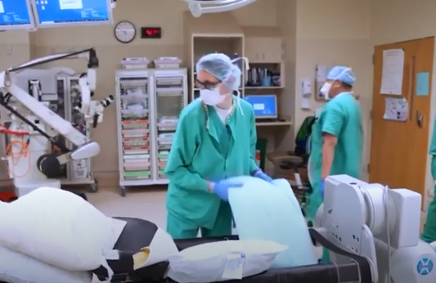
Essential Workers in Project SEARCH
This Project SEARCH graduate is proud to be an essential worker on the front lines at UCHealth University of Colorado Hospital.

