Slide 1
Emily Stewart
Executive Director, Community Catalyst
January 14, 2021

Slide 2
Our Founding Principle
Good health care decisions require community voice.

Slide 3
Olivia’s Story

Slide 4
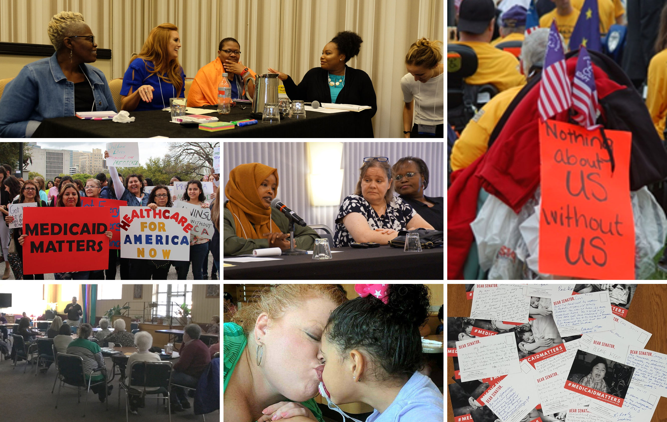
Why Centering Consumer Voice Matters

Slide 5
The Need and The Moment.
Policy Opportunity.
Matched by a huge need for ideas & evidenced-based solutions.
Solutions rooted in what people need, especially those most hurt by our system today.
Solutions centered on advancing health equity.

Slide 6
Approach.
TRUST
ENGAGING AT THE OUTSET
COMMUNITY RESOURCES
FLEXIBILITY AND PATIENCE

Slide 7
Methods
Engaging community-based orgs; taskforces
Consumer panels & advisory boards
Focus groups

Slide 8
Consumer Leadership
Crystal
I am: “Creative, Energetic, Passionate, Activist”
“What matters most to me is being able to live independently and actively and raise my daughter in the community; having access to health care I need at home versus being stuck in facilities for weeks and months at a time. I have a very complex medical situation, so accessing health care that understands my needs and meets them is critical.”
Don
I am: “Free, Creative, Adapting, Affordable, Compensating”
“I had a stroke due to a dissection of my carotid artery after a bike accident in 2002. What matters is being in control of my health, being the one who decides along with my caregiver what’s best for me, not being told what I need.”
Sherman
I am: “Active, An Advocate, Someone Who Cares About People”
“Having Medicare and Medicaid is big. It really matters because it pays for bills that I couldn’t otherwise afford, especially at my age. When you can’t afford any insurance, you can’t afford health.”
Lois
I am: “Kind, Someone Who Tries to Behave Myself, Outspoken, a Pain in the Ass”
“Because I have Medicare and Medicaid, even though I’ve had medical problems, I haven’t got a care, because everything I need is covered and I’ve had very good care for everything I need and am able to keep living here in my apartment.”

Slide 9
THANK YOU

