Slide 1
Employment Challenges and Opportunities post COVID John Butterworth Interagency Committee on Disability Research July 28, 2020
Notes:
Brief summary of where we are nationally
We have challenges at three levels:
Systems that establish a priority for employment
Organizations that get there
Supports that are innovative, flexible, and creative

Slide 2
Percent change in number employed compared to February 2020: General population
2021
2021
Source: Bureau of Labor Statistics Monthly Employment Situation
Notes:
Chart details: The number of individuals with a disability declined by 18.8% from February to April, and by 15.1% from February to July.
The number of individuals with no disability declined by 15.5% from February to April and 8.3% from February to July.
Individuals without disabilities lost jobs at a slightly lower rate than individuals with disabilities, but the recovery started more rapidly.
Source: Bureau of Labor Statistics Monthly Employment Situation.

Slide 3
Percent who continued working after March 1 Individuals supported by a state IDD agency
Data from 7 SELN member states
Individual CIE n=10,420
Group SE n=2,780
Collected late May to June 2020
Notes:
John
Full chart description:
Data reflects work status in May and June 2020 for individuals who were working on March 1 2020.
People working in individual competitive integrated jobs. 46% were still working. 30% were furloughed. 8% were laid off. 14% were voluntarily not working.
People working in group supported jobs, 36% were still working, 45% were furloughed, 55 were laid off. 18% were voluntarily not working,
Total n was 10,420 in individual jobs and 2,780 in group supported jobs.

Slide 4
Maryland percent participating by activity February 2020 to October 2020
Source: Maryland DDA Employment Outcome Information System
Notes:
John

Slide 5
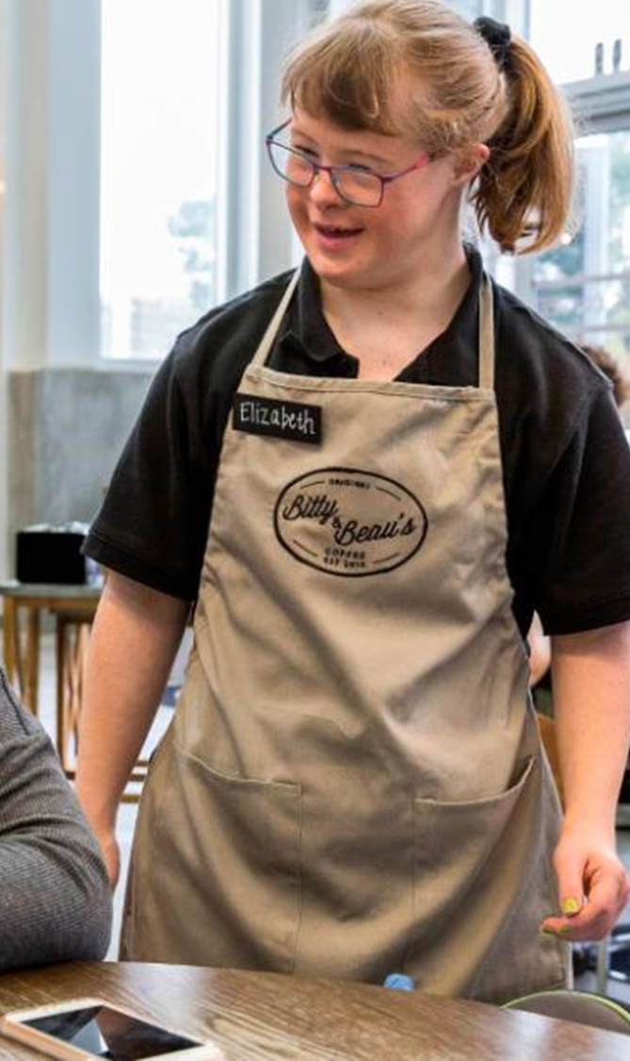
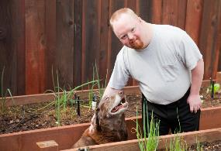
Seizing Opportunity for Service Innovation: Supporting Meaningful Lives
a meaningful life is a construct having to do with the purpose, significance, fulfillment, and satisfaction of life.
Notes:
Rie… A moment in time – to course correct and provider services and supports work for people with DD to have a truly meaningful life.

Slide 6
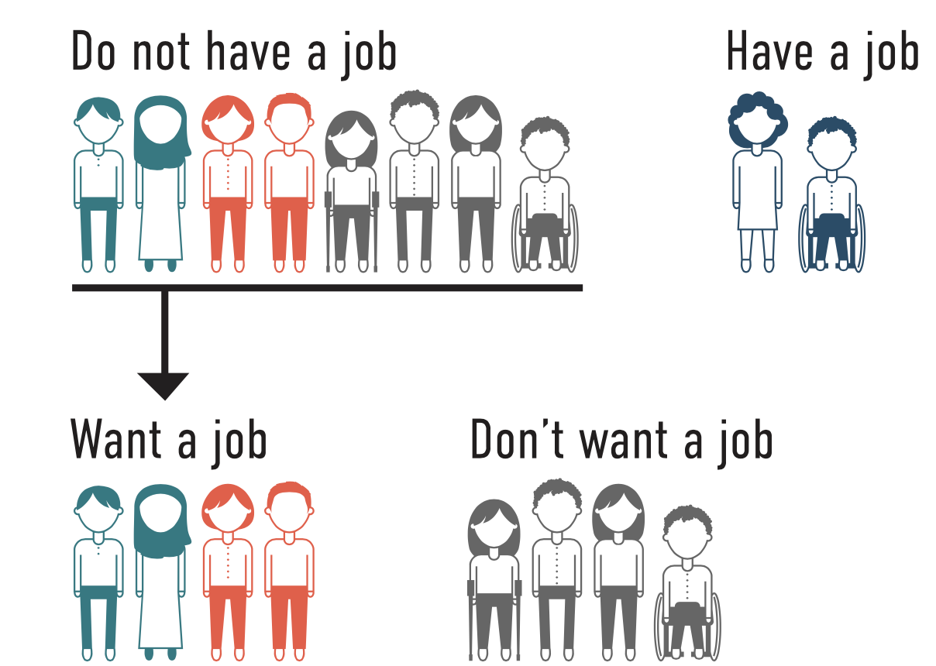
National Core Indicators Data
Source: National Core Indicators
Notes:
RIE… Prior to the pandemic – National Core Indicators Data told us that many more people would prefer to work and just like the non disabilities population some people don’t want to work.

Slide 7
Maryland – Type of support 10/2020
Source: Maryland DDA Employment Outcome Information System
Notes:
John
Individual job consists of 32% remote support, 30% Both.
Group job costs of 5% remote support, 18% both.
FB Job is 21% both (no remote support).
CB Non Work consists of 30% remote supports, 12% both.
FB Non Work consists of 50% remote support, 20% both.

Slide 8
Percent using remote/virtual employment supports
Notes:
John

Slide 9
Do you plan to continue to use remote/ virtual supports post COVID?
Notes:
John

Slide 10
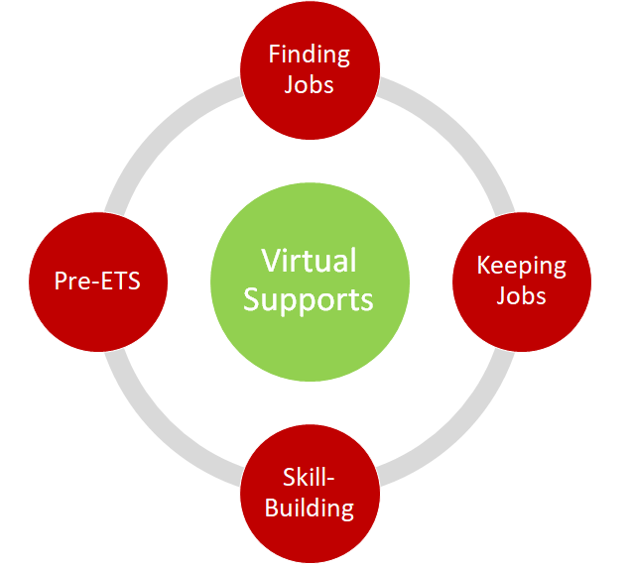
Virtual Supports
Virtual coffee dates
Virtual job clubs
Remote interviews
Remote check-ins and real-time supports
Natural supports
Remote job shadowing
Virtual Supports
Adapted from work of ICI and
10

Slide 11
What Families Said Was Helpful During COVID-19 and Wish to Keep/Adapt/Expand
Self Advocacy Peer to Peer
Person Learned New Skills
Peer to Peer
More Individualized
Source: Fall 2020 Innovation Roundtable discussions from the Community of Practice for Supporting Families project
Notes:
While many families of people with disabilities have found the pandemic stressful, disruptive and difficult as it has been for most Americans, some themes have emerged in what has helped –and considerations for keeping for the long term

Slide 12
Technology …
Increases control
Provides additional ways of learning new skills and meeting new people
Can be less intrusive in employment environments
Facilitates individuals being connected
Requires support to use the equipment first and keep software updated
Source: Fall 2020 Innovation Roundtable discussions from the Community of Practice for Supporting Families project
Notes:
John

Slide 13
Imagining the future
Flexibility
Schedules • Activities • Settings • Supports •
Individualization
Connections
Discovery and job exploration
Virtual and remote supports
Notes:
Rie

Slide 14
Contact
John Butterworth
john.butterworth@umb.edu
www.ThinkWork.org
www.seln.org

