Slide 1

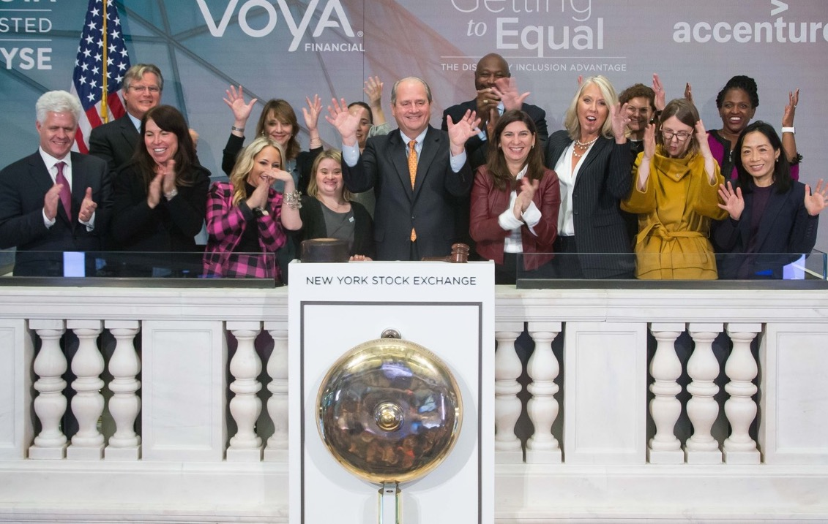
THE LEADING NONPROFIT RESOURCE FOR BUSINESS DISABILITY INCLUSION WORLDWIDE.
We empower business to achieve disability inclusion and equality.
Our network of more than 270 corporations expands opportunities for people with disabilities across enterprises.
Learn more at: DisabilityIN.org
Notes:
No feedback

Slide 2



A Joint Initiative:
The Disability Equality Index
WHAT IS THE DEI?
A comprehensive benchmarking tool that helps companies build a roadmap of measurable, tangible actions.
Participating companies receives a score, on a scale of zero (0) to 100, with those earning 80 and above recognized as “Best Places to Work for Disability Inclusion.”
A JOINT INITIATIVE:
Learn more about the DEI at www.DisabilityEqualityIndex.org.

Slide 3
ACTION INSIDE THE DEI:
MORE THAN JUST A PLEDGE
Disability Equality Index Points Distribution (100 Total)
NON-U.S.
OPERATIONS,
UNWEIGHTED
CULTURE, 20
LEADERSHIP,
10
BENEFITS,
10
RECRUITMENT,
10
EMPLOYEMENT,
EDUCATION,
RETENTION &
ADVANCEMENT
10
ACCOMMODATIONS,
10
Notes:
Move EP to after EWA✓
Adj. given add. visual feedback. ✓

Slide 4

The Disability Advantage Yields Results
28% Higher Revenue
2x
Net Income
30% Stronger Profits
2x Stronger Shareholder Returns
Source: Getting to Equal 2018, The Disability Inclusion Advantage

Slide 5


Take Action
Sign CEO-to-CEO Letter
Over 60 CEOs from all over the world have signed a letter urging Fortune 1000 companies to advance disability inclusion.
JOIN IN The Global Campaign for Disability Inclusion
We all have a role to play in building an inclusive global economy. Join IN! Visit INforInclusion.org.
Sign Joint Investor Statement
30 Investors, representing over $2.8 trillion in assets, signed the Joint Investor Statement on Disability Inclusion urging portfolio companies to advance inclusion.
Notes:
The Disability:IN CEO-to-CEO Letter is shared on our Are You IN campaign page. It has been shared in various PR announcements – and is shared when announcing a new CEO becoming a signatory both via email communications and social media.

